Slide 1

PENINGKATAN REPUTASI PERGURUAN TINGGI INDONESIA MENUJU WORLD CLASS UNIVERSITY (WCU)
DIREKTORAT PEMBINAAN KELEMBAGAAN PERGURUAN TINGGI
DIREKTORAT JENDERAL KELEMBAGAAN, ILMU PENGETAHUAN, TEKNOLOGI DAN PENDIDIKAN TINGGI KEMENTERIAN RISET, TEKNOLOGI, DAN PENDIDIKAN TINGGI

Slide 2
OUTLINE
Pendahuluan: WCU, Pencapaian, Indikator program dan target Dirjen Kelembagaan
Latar belakang: Pemeringkatan Universitas Metode pemeringkatan QS Rangking
Angka dan Data: Hasil Pemeringkatan, Analisis good practice, dan Analisis bobot kriteria PT Indonesia
Solusi Jangka Pendek dan Jangka Panjang
Proyeksi Pemeringkatan Perguruan Tinggi

Slide 3
OUTLINE
Pendahuluan
Latar belakang
Ranking Criteria
Methodology
Survey Results & Data
Solusi Jangka Pendek dan Jangka Panjang

Slide 4
PENDAHULUAN

Slide 5
World Class University (through WUR)
Syarat WCU menurut Henry M. Levin:
Excellence in Research
Academic freedom & an atmosphere of intellectual excitement
Self-governance
Adequate facilities & funding
Diversity
Internationalization: students, scholars, and faculty from abroad
Democratic leadership
A talented undergraduate body
Use of ICT, efficiency of management, Library
Quality of teaching
Connection with Society/community needs
Within Institutional Collaboration

Slide 6
Dilema WCU (Philip G. Altbach)
Putting too much stress on attaining WCU status may harm an academic system. It may divert energy and resources from more important and perhaps more realistic goals. It may focus too much on building a research-oriented and elite university at the expense of expanding access or serving national needs

Slide 7
Kriteria WUR yang diambil dan posisi PT di Indonesia
goal yg realistik
Mendukung Academic system yg ada
meningkatkan kualitas dan kuantitas dalam Tri Darma PT
Peningkatan level Univ (Excelence dlm Teaching, dlm Research, dlm Research yg diindustrikan)

Slide 8
Pencapaian Dikti 2009 - 2014
KODE | INDIKATOR KINERJA UTAMA | 2010 |  | 2011 |  | 2012 |  | 2013 |  | 2014
 |  | TARGET | REALISASI | TARGET | REALISASI | TARGET | REALISASI | TARGET | REALISASI | TARGET
4.1 | APK PT Dan PTA Usia 19-23 Thn *) | 22,8% | 24.67% | 25,10% | 27.01 % | 26,75% | 28,6% | 29,10% | 29,87% | 30%
4.2 | Rasio Kesetaraan Gender PT | 111,8% | 107.6% | 107,9% | 103.54% | 104,6% | 106,8% | 103,2% | 109,6% | 103,0%
4.3 | Jumlah PT PK BLU/BLU (PT BH) | 20 | 20 | 27 | 21 | 35 | 33 | 35 | 33 | 40
4.4 | Jumlah PT Beropini WTP Dari KAP | 11 | 6 | 20 | 18 | 22 | 18 | 26 | 0* | 30
4.5 | Persentase Prodi Terakreditasi | 56,76% | 72% | 62,73% | 59.93% | 69% | 68,74% | 100% | 88% | 100%
4.6 | Persentase Prodi PT Berakreditasi Minimal B | 49,63% | 58.6% | 50% | 56.15% | 51% | 52,67% | 57,03% | 49,30% | 58%
4.7 | Jumlah Perguruan Tinggi Masuk Top 500 Dunia | 3 | 4 | 5 | 3 | 6 | 3 | 8 | 2 | 11
4.8 | Rasio Mhs Vokasi : Total Mhs Vokasi Dan S-1 | 19% | 18,70% | 21% | 18.11% | 24% | 17,4% | 27% | 16,60% | 30%
4.9 | APK Prodi Sains Natural Dan Teknologi (Usia 19-23 Tahun) | 4,1% | 5.74% | 5% | 8.06% | 7% | 7,3% | 9,0% | 7,0% | 10%
4.10 | Persentase Dosen Berkualifikasi Minimal S2 | 59,5% | 62% | 61,5% | 67.4% | 63,3% | 63,3% | 65,5% | 60,67% | 70%
4.11 | Persentase Dosen Berkualifikasi S-3 | 9,8% | 9,50% | 10,1% | 13.5% | 10,3% | 10,3% | 12,5% | 11,80% | 15%
4.12 | Persentase Dosen Bersertifikat | 23% | 21.9% | 36% | 34.5% | 50% | 43,2% | 62,5% | 72,28% | 75%
4.13 | Jumlah Dosen Dengan Publikasi Nasional | 5% | 17.2% | 5,2% | 5.5% | 5,4% | 6,38% | 5,5% | 10,50% | 5,7%
4.14 | Jumlah Dosen Dengan Publikasi Internasional | 0,4% | 0,75% | 0,5% | 0.75% | 0,6% | 0,63% | 0,7% | 2,1% | 0,8%
4.15 | Jumlah HKI Yang Dihasilkan | 75 | 76 | 95 | 134 | 110 | 212 | 130 | 152 | 150
4.16 | Persentase Mahasiswa Penerima Beasiswa/Bantuan Biaya Pendidikan | 9,4% | 7.3% | 13% | 11.46% | 15% | 10,25% | 18% | 11,30% | 20%
Strategic Objective
AKSES
AKSES
MUTU
TATA KELOLA
MUTU
MUTU
DAYA SAING
RELEVANSI
RELEVANSI
MUTU
MUTU
MUTU
MUTU
MUTU
MUTU
TATA KELOLA

Slide 9


INDIKATOR PROGRAM DAN TARGET DIRJEN KELEMBAGAAN
Program Penguatan Kelembagaan
No | Indikator Program | Target |  |  |  |  | Keterangan
 |  | 2015 | 2016 | 2017 | 2018 | 2019
1 | Jumlah Perguruan Tinggi masuk top 500 dunia | 2 | 3 | 3 | 4 | 5 | Kumulatif
2 | Jumlah Perguruan Tinggi berakreditasi A (Unggul) | 29 | 39 | 53 | 99 | 194 | Kumulatif
3 | Jumlah Taman Sains dan Teknologi (TST) yang dibangun | 77 | 100 | 100 | 100 | 100 | Nominal lokasi tetap
4 | Jumlah TST yang mature → (menghasilkan teknologi yang siap untuk diterapkan dalam lingkungan sesungguhnya (Taman Sains), menghasilkan usaha baru secara berkesinambungan (Taman Tekno), melaksanakan riset berkesinambungan, menghasilkan perusahaan pemula dan mampu menarik industri (N-TST) | 6 | 14 | 27 | 50 | 58 | Kumulatif
5 | Pusat Unggulan Iptek | 12 | 15 | 20 | 25 | 30 | Kumulatif

Slide 10
LATAR BELAKANG

Slide 11
PEMERINGKAT UNIVERSITAS
Webometrics, http://www.webometrics.info
THES (Times Higher Education Supplement)
ARWU (Academic Ranking of World Universities), http://www.shanghairanking.com
QS World University Rankings, http://www.topuniversities.com
Dll

Slide 12
RANKING CRITERIA

Slide 13
WEBOMETRICS (South East Asia)
SEA Rank | World Rank | Univ. | Presence Rank | Impact Rank | Opennes Rank | Excellence Rank
1 | 116 | NUS | 767 | 202 | 210 | 40
5 | 518 | UGM | 295 | 534 | 16 | 2137
11 | 660 | UI | 240 | 856 | 219 | 1867
14 | 704 | ITB | 618 | 410 | 548 | 2252
20 | 1016 | IPB | 520 | 1764 | 11 | 2793
CRITERIA:
Visibility (50%) : inbound link
Collected from Majestic SEO and ahrefs
Activity (50%)
Presence(1/3) : number of webpages of univ. hosted in the main webdomain as indexed by Google
Opennes(1/3) : number of rich files (pdf, doc, docx,ppt) published in dedicated websites according to Google Scholar
Excellence(1/3) : 10% most cited papers in respective field (Scimago) for five year period

Slide 14
WEBOMETRICS (Indonesia)
 | July 2011 | Jan 2012 | July 2012 | Jan 2013 | July 2013 | Jan 2014 | July2014 | Jan 2015
ITB | 632 | 277 | 568 | 497 | 600 | 568 | 622 | 704
UGM | 817 | 249 | 381 | 440 | 640 | 379 | 414 | 518
UI | 526 | 365 | 507 | 581 | 653 | 507 | 532 | 660
Strongly linked to
Volume
Quality of contents
Size dependent

Slide 15
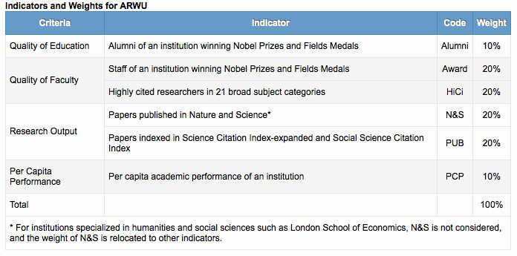
ARWU
Catatan :
Kriteria ARWU berorientasi saintifik
Belum ada univ di Indonesia yg tercatat dalam peringkat ARWU

Slide 16
QS World Univ. Rangkings

Slide 17
QS World Univ. Rangkings
50 %
SURVEY
40 % Academic
10% Employer
50 %
DATA
20% Citation/faculty
10% Faculty/student
5% Int’l Faculty
5% Int’l Students

Slide 18
QS Asia University Ranking

Slide 19
QS AUR - WUR

Slide 20
METHODOLOGY QS WUR & AUR

Slide 21
METHODOLOGY
Academic reputation, based on a global survey of academics (40%) (Measured by using a global survey, in which academics are asked to identify the institutions where they believe the best work is currently taking place within their field of expertise)
Employer reputation, based on a global survey of graduate employers (10%) (Asked employers to identify the universities they perceived as producing the best graduates. This indicator is unique among international university rankings
Faculty/student ratio, an indication of a commitment to teaching (20%) (Measured the number of academic staff employed relative to the number of students enrolled. In the absence of an international standard by which to measure teaching quality, it provides an insight into the universities that are best equipped to provide small class sizes and a good level of individual supervision.

Slide 22
METHODOLOGY
Citations per faculty, an indication of research impact (20%) (Aimed to assess universities’ research output. QS collects this information using Scopus)
International student ratio, measuring international diversity of the student community (5%)
International staff ratio, measuring international diversity of the academic faculty (5%) (Aimed to assess how successful a university has been in attracting students and faculty members from other nations)

Slide 23
METHODOLOGY
Samuel Wong, Senior Researcher QS Intelligent Unit, 2015

Slide 24
SURVEY RESULTS & DATA QS WUR

Slide 25
QS WUR 10 Negara Asia
Tahun
Singapura
Taiwan
Peringkat
Indonesia
Catatan: Indonesia (UI)

Slide 26
QS WUR 10 Negara Asia
Univ | World Rank | Overall Score
MIT | 1 | 100
NUS | 22 | 91.1
UI | 310 | 40.9
ITB | 461-470 (431-440)
UGM | 551-600
IPB, Unair, Unpad, ITS, Undip, UB, UNS, UNHAS | 701+

Slide 27
Data WUR PT Indonesia 2014-2015
No | PT | Ranking WUR |  |  | Over all Score |  | Academic Reputation |  | Employer Reputation |  | Faculty Student |  | Citation per Faculty |  | International Faculty |  | International Students
 |  | 2013 | 2014 | 2015 | 2014 | 2015 | 2014 | 2015 | 2014 | 2015 | 2014 | 2015 | 2014 | 2015 | 2014 | 2015 | 2014 | 2015
1 | UI | 309 | 310 | 358 | 40.9 | 37.7 | 51.3 | 50.5 | 65.5 | 61.3 | 55.7 | 43.6 | 1.7 | 1.8 | 40.3 | 38.7 | 5 | 5.7
2 | ITB | 461-470 | 461-470 | 431-440 | 31 | n.a | n.a | 51.4 | n.a | 59 | 19.5 | n.a | 2.8 | n.a | n.a | n.a | 2.6 | n.a
3 | UGM | 501 | 551-600 | 551-600 | n.a | n.a | 44.8 | n.a | 42.4 | n.a | n.a | n.a | n.a | n.a | n.a | n.a | n.a | n.a
4 | IPB | 701+ | 701+ | 701+ | n.a | n.a | n.a | n.a | n.a | n.a | n.a | n.a | n.a | n.a | n.a | n.a | n.a | n.a
5 | UNAIR | 701+ | 701+ | 701+ | n.a | n.a | n.a | n.a | n.a | n.a | n.a | n.a | n.a | n.a | n.a | n.a | n.a | n.a
6 | UNPAD | 701+ | 701+ | 701+ | n.a | n.a | n.a | n.a | n.a | n.a | n.a | n.a | n.a | n.a | n.a | n.a | n.a | n.a
7 | ITS | 701+ | 701+ | 701+ | n.a | n.a | n.a | n.a | n.a | n.a | n.a | n.a | n.a | n.a | n.a | n.a | n.a | n.a
8 | UNDIP | 701+ | 701+ | 701+ | n.a | n.a | n.a | n.a | n.a | n.a | n.a | n.a | n.a | n.a | n.a | n.a | n.a | n.a
9 | UB | 701+ | 701+ | 701+ | n.a | n.a | n.a | n.a | n.a | n.a | n.a | n.a | n.a | n.a | n.a | n.a | n.a | n.a
10 | UNS | 701+ | 701+ | 701+ | n.a | n.a | n.a | n.a | n.a | n.a | n.a | n.a | n.a | n.a | n.a | n.a | n.a | n.a
11 | UNHAS | 701+ | 701+ | 701+ | n.a | n.a | n.a | n.a | n.a | n.a | n.a | n.a | n.a | n.a | n.a | n.a | n.a | n.a

Slide 28
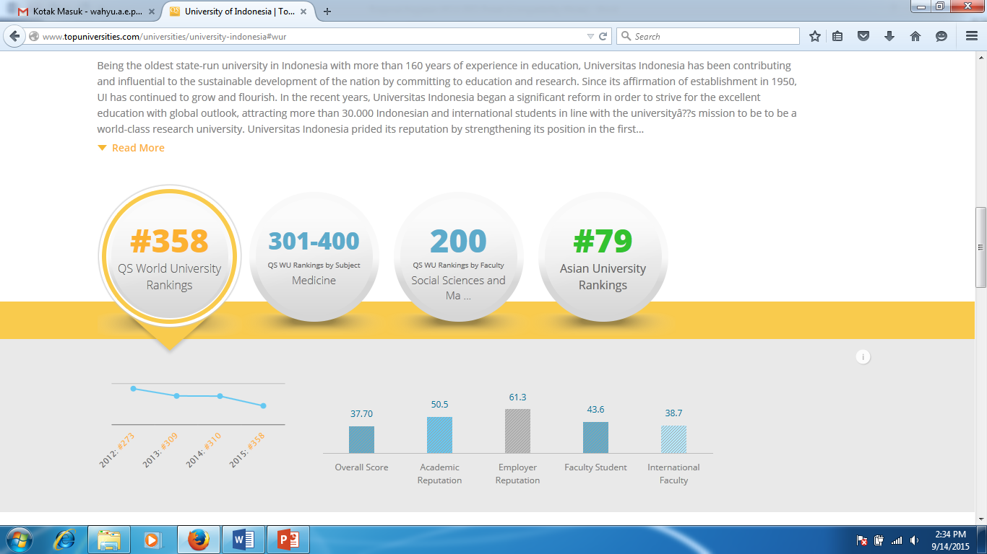
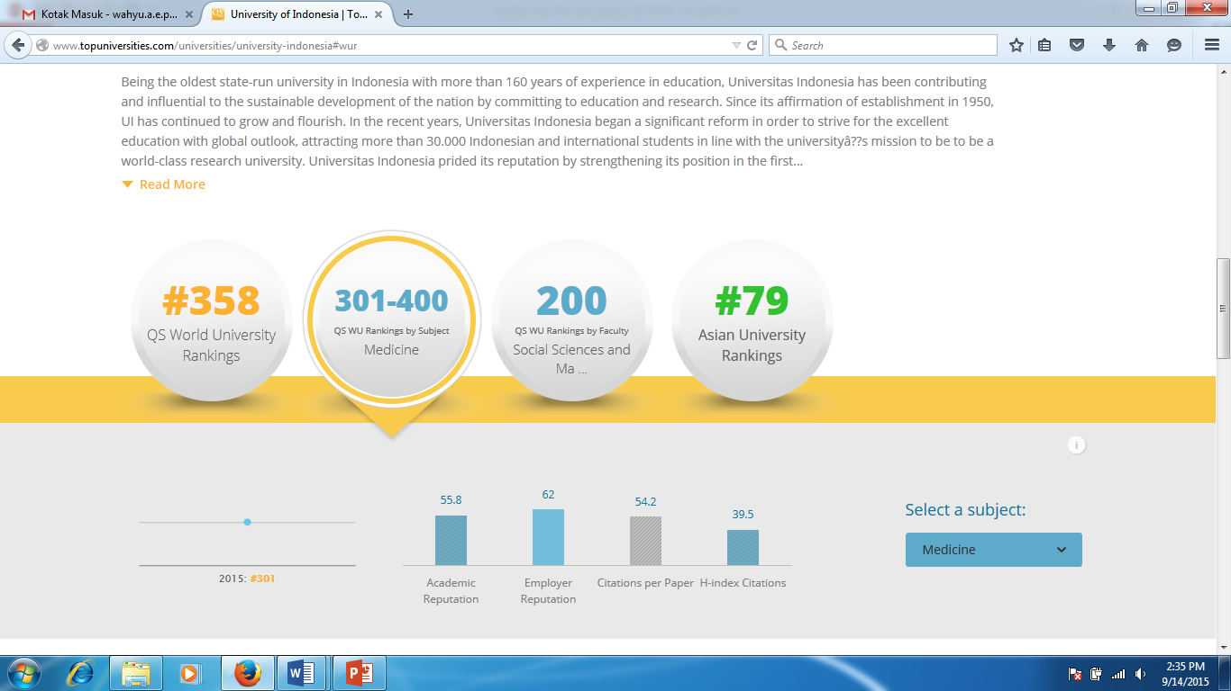
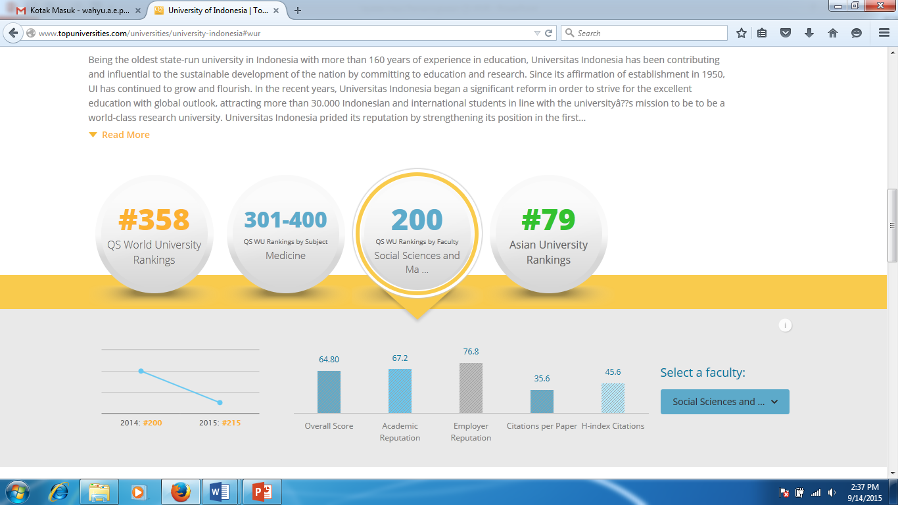
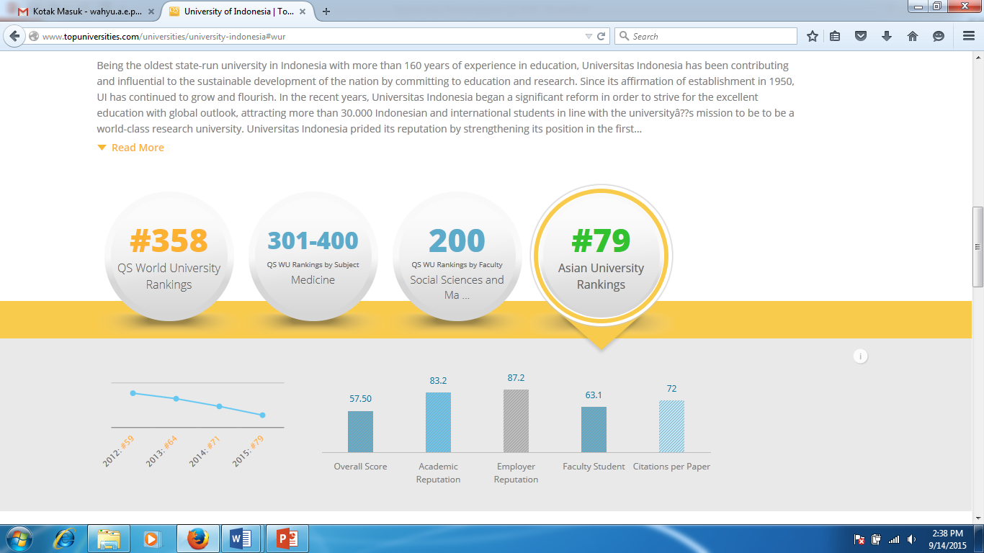
Universitas Indonesia

Slide 29
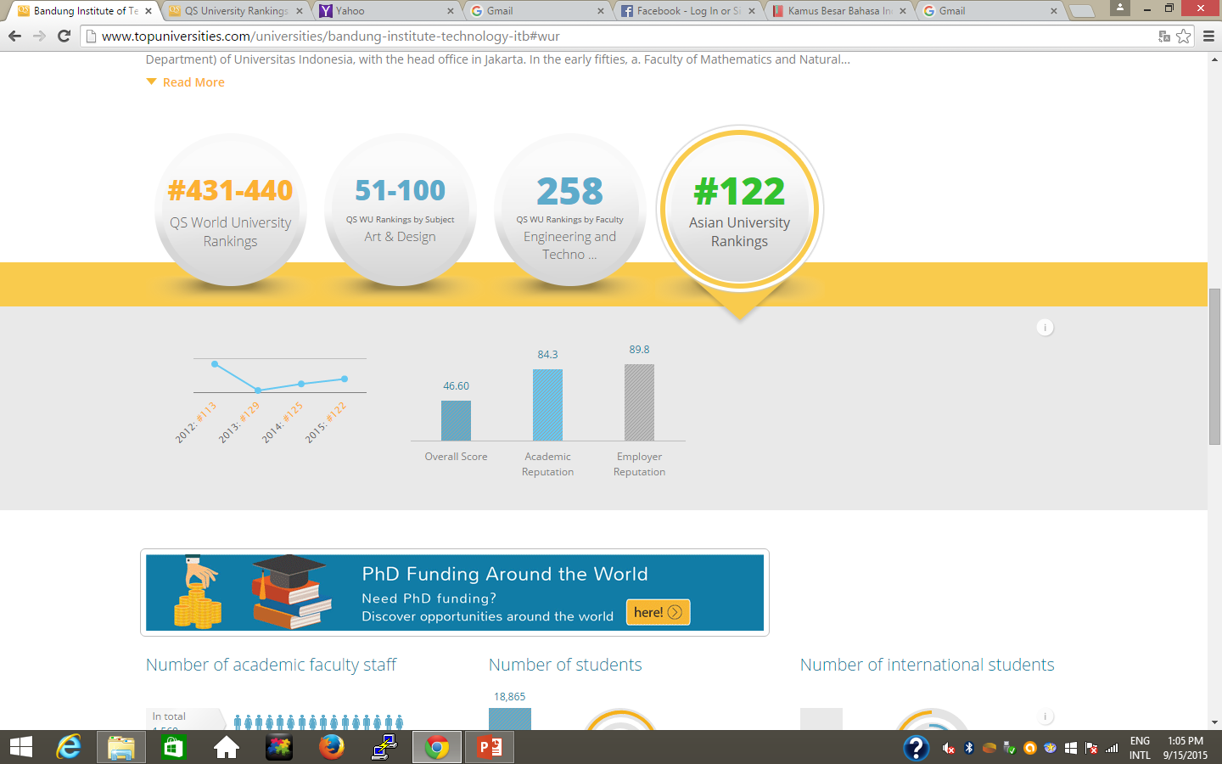
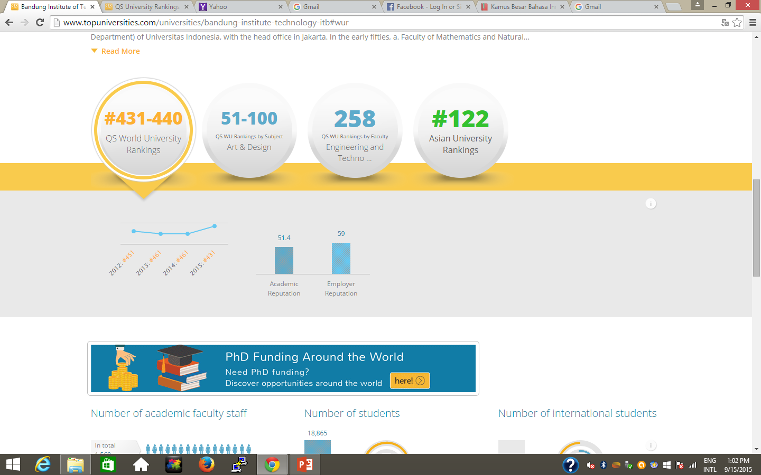
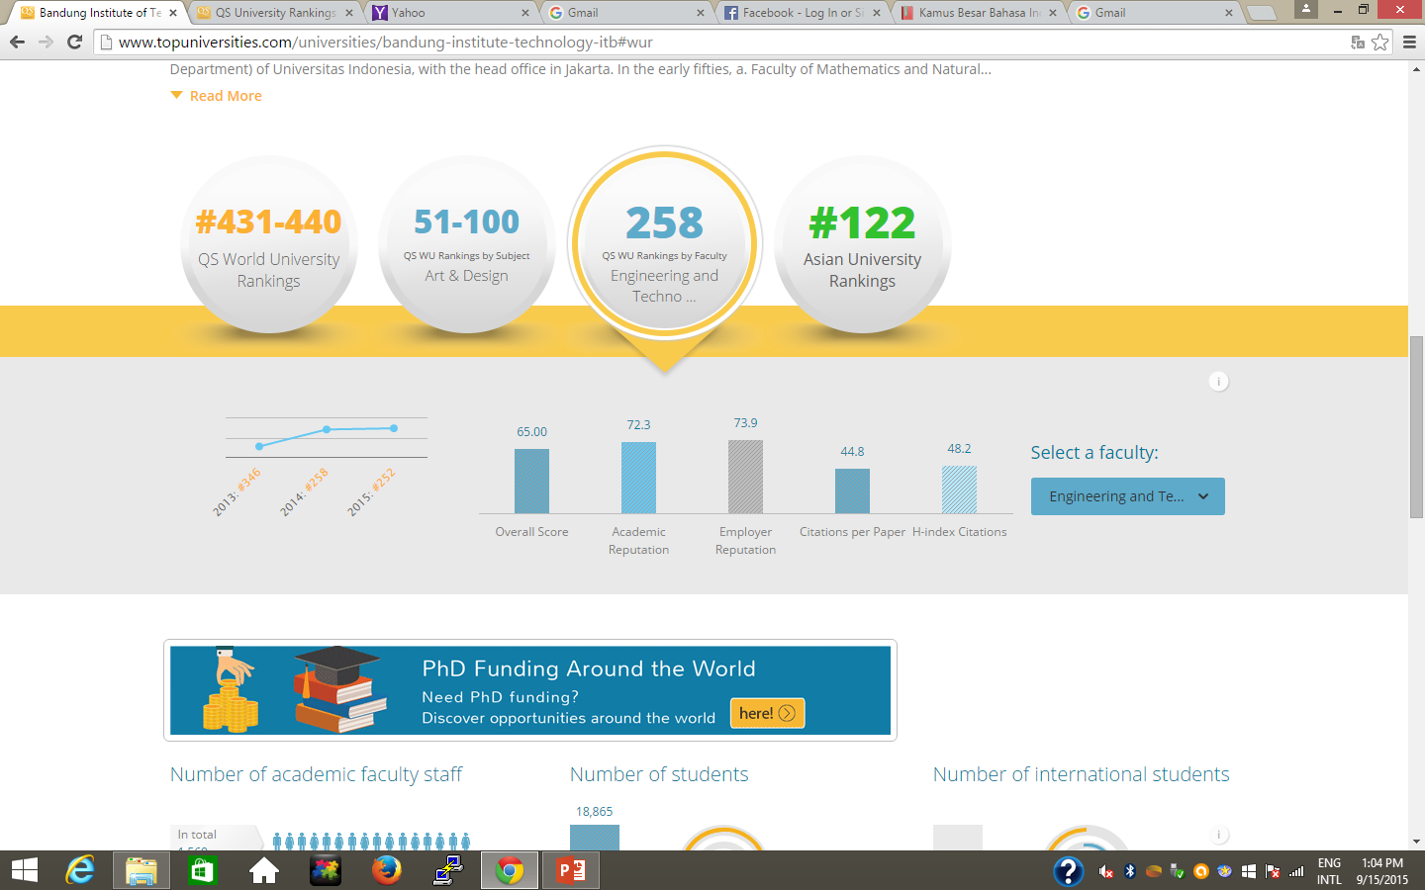
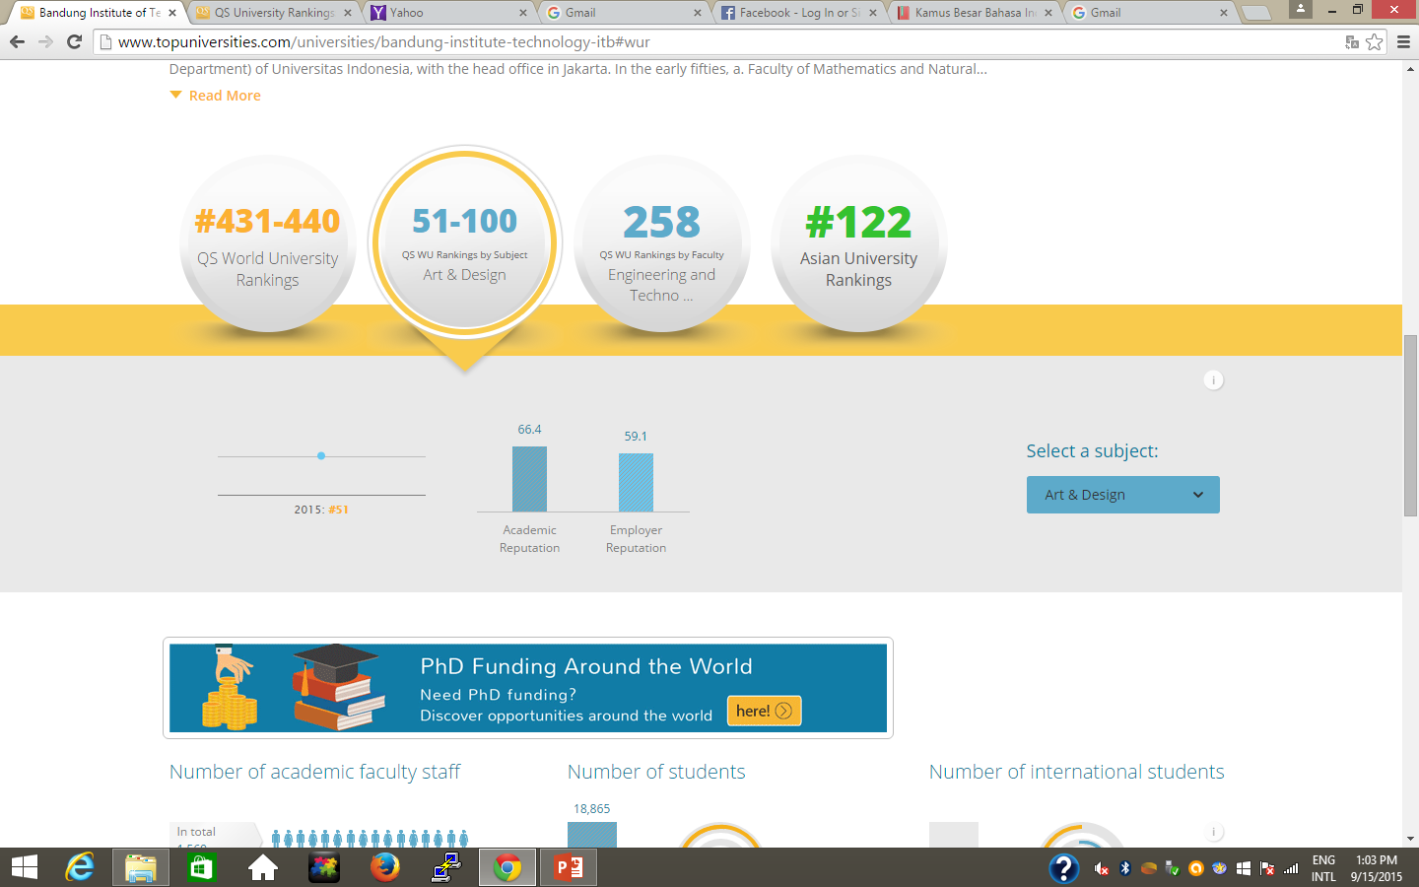
Institut Teknologi Bandung

Slide 30
QS Rank by Fac. 2014/2015 (Social Sciences & Management)
World Rank | Univ | Score
1 | Harvard | 97.3
6 | MIT | 96.9
9 | NUS | 89.0
200 | UI | 67.4
364 | ITB | 61.0

Slide 31
QS Rank by Fac. 2014/2015 (Engineering & Technology)
World Rank | Univ | Score
1 | MIT | 97.8
2 | Stanford Univ | 96
7 | NUS | 92.2
8 | Caltech | 91.5
258 | ITB | 67.3
Other QS WUR by Subjects……..

Slide 32
SURVEY RESULTS & DATA QS AUR Samuel Wong, Senior Researcher QS Intelligent Unit, 2015

Slide 33
Kriteria penilaian QS AUR

Slide 34
Trend for QS AUR
2015 | 2014 | 2013 | INSTITUTION | TREND
1 | 1 | 2 | National University of Singapore (NUS)
2 | 3 | 2 | The University of Hong-Kong (HKU)
3 | 2 | 6 | KAIST – Korea Advanced Institute of Science and Technology
4 | 7 | 10 | Nanyang Technological University (NTU)
5 | 5 | 1 | Hong Kong University of Science and Technology (HKUST)
6 | 6 | 7 | The Chinese University of Hong Kong
7 | 8 | 5 | Peking University (PKU)
8 | 4 | 4 | Seoul National University (SNU)
9 | 11 | 12 | City University of Hong Kong
10 | 9 | 7 | Pohang University of Science & Technology (POSTECH)
Samuel Wong, Senior Researcher QS Intelligent Unit, 2015

Slide 35
Indonesian Universities in QS AUR
 |  | RANK 2015 | RANK 2014 | DELTA 15/14
1 | Universitas Indonesia | 79 | 71 | -8
2 | Bandung Institute of technology (ITB) | 122 | 125 = | 3
3 | Universitas Gadjah Mada | 137 = | 145 = | 8
4 | Universitas Airlangga | 147 | 127 | -20
5 | Universitas Padjadjaran | 161-170 | 201-250 | 60
6 | Bogor Agricultural University (IPB) | 201-250 | 201-250 | 0
7 | Universitas Diponegoro | 251-300 | 201-250 | -20
8 | Universitas Muhammadiyah Surakarta | 301+ | 301+ | 0
9 | Universitas Brawijaya | 301+ | 251-300 | -20
10 | Universitas Udayana | 301+ | 251-300 | -20
Samuel Wong, Senior Researcher QS Intelligent Unit, 2015

Slide 36
Indonesian Universities in QS AUR
 |  | RANK 2015 | RANK 2014 | RANK 2013
1 | Universitas Indonesia | 79 | 71 | 64 =
2 | Bandung Institute of technology (ITB) | 122 | 125 = | 129
3 | Universitas Gadjah Mada | 137 = | 145 = | 133 =
4 | Universitas Airlangga | 147 | 127 | 145
5 | Universitas Padjadjaran | 161-170 | 201-250 | 201-250
6 | Bogor Agricultural University (IPB) | 201-250 | 201-250 | 201-250
7 | Universitas Diponegoro | 251-300 | 201-250 | 201-250
8 | Universitas Muhammadiyah Surakarta | 301+ | 301+ | -
9 | Universitas Brawijaya | 301+ | 251-300 | 201-250
10 | Universitas Udayana | 301+ | 251-300 | 251-300
Samuel Wong, Senior Researcher QS Intelligent Unit, 2015

Slide 37
Regional Universities in QS AUR
No | Institution | Country | Ranking 2015
1 | National Taiwan University | Taiwan | 22
2 | University Malaya | Malaysia | 29
3 | Indian Institute of Science | India | 34
4 | Mahidol University | Thailand | 44
5 | University of Philippines | Philippines | 70
6 | Universitas Indonesia | Indonesia | 79
7 | Pakistan Institute of Engineering and Applied Sciences (PIEAS) | Pakistan | 115
8 | University of Brunei Darussalam | Brunei | 118
9 | University of Dhaka | Bangladesh | 126
10 | University of Colombo | Sri Lanka | 159
11 | University of Macau | Macau | 166=
12 | Vietnam National University (Hanoi) | Vietnam | 191=
Samuel Wong, Senior Researcher QS Intelligent Unit, 2015

Slide 38
Faculty Area Ranking, QS AUR
FACULTY | UI | ITB | UGM | UA | UNPAD | IPB | UNDIP
Arts and Humanities | 40 | 65 | 39 | 101-200 | 101-200 | 101-200 | 101-200
Eng / IT | 63 | 41 | 69 | 101-200 | 201+ | 101-200 | 101-200
Life Sciences & Medicine | 39 | 40 | 41 | 78 | N.A | 54 | 101-200
Natural Sciences | 78 | 46 | 91 | 101-200 | 201+ | 99 | 101-200
Social Science and Management | 28 | 48 | 39 | 82 | 101-200 | 101-200 | 101-200
Samuel Wong, Senior Researcher QS Intelligent Unit, 2015

Slide 39
Ranking indicators, QS AUR
INDICATOR | UI | ITB | UGM | UA | UNPAD | IPB | UNDIP
Academic Reputation | 45 | 42 | 56 | 110 | 171 | 107 | 146
Employer Reputation | 44 | 37 | 74 | 120 | 84 | 126 | 141
Faculty Student Ratio | 123 | 320 | 325 | 293 | 246 | 311 | 408
Paper per Faculty | 403 | 292 | 404 | 434 | 441 | 390 | 432
Citations per Paper | 308 | 411 | 278 | 25 | 82 | 292 | 264
International Faculty | 37 | - | 231 | 302 | 328 | 226 | 284
International Students | 227 | 341 | 294 | 403 | 221 | 353 | 428
Inbound Exchange | 62 | 288 | 155 | 207 | 163 | 229 | 298
Outbound Exchange | 63 | 238 | 111 | 253 | 138 | 229 | 239
Samuel Wong, Senior Researcher QS Intelligent Unit, 2015

Slide 40
Indicators’ score, QS AUR
INDICATOR | UI | ITB | UGM | UA | UNPAD | IPB | UNDIP | MED
Academic Reputation | 88.2 | 64.3 | 79.2 | 48.8 | 30.9 | 49.6 | 39.6 | 37.9
Employer Reputation | 87.2 | 89.9 | 66.7 | 47.4 | 62.6 | 45.6 | 40.0 | 37.4
Faculty Student Ratio | 63.1 | 29.1 | 28.5 | 32.2 | 38.0 | 29.6 | 18.9 | 54.8
Paper per Faculty | 3.8 | 16.7 | 3.8 | 2.3 | 2.0 | 5.2 | 2.3 | 46.5
Citations per Paper | 25.4 | 8.1 | 30.2 | 94.6 | 80.0 | 27.8 | 33.0 | 61.9
International Faculty | 72.0 | - | 15.2 | 6.4 | 4.1 | 15.7 | 8.5 | 27.9
International Students | 13.9 | 5.6 | 8.6 | 2.8 | 14.6 | 5.1 | 1.7 | 23.3
Inbound Exchange | 26.6 | 1.6 | 5.0 | 3.1 | 4.5 | 2.7 | 1.5 | 5.4
Outbound Exchange | 34.1 | 3.4 | 16.2 | 3.0 | 10.4 | 1.8 | 3.4 | 8.5
Samuel Wong, Senior Researcher QS Intelligent Unit, 2015

Slide 41
5 YEARS RESEARCH PAPERS AND CITATIONS, 2010-2014
INDICATOR | UI | ITB | UGM | UA | UNPAD | IPB | UNDIP
Research Paper | 2002 | 2657 | 1098 | 364 | 398 | 900 | 451
Citations (excl. self citation) | 3308 | 2244 | 1995 | 830 | 1360 | 1563 | 818
Productivity | 1.65 | 0.84 | 1.82 | 2.28 | 3.42 | 1.74 | 1.81
Samuel Wong, Senior Researcher QS Intelligent Unit, 2015

Slide 42
Kinerja Publikasi PT Indonesia 1990-2014

Slide 43
Kecepatan Kinerja Publikasi 2010-2014

Slide 44
Kinerja Publikasi 2010-2014
 | Institusi | Health | Life | Social | Engineering
1 | ITB | 2.22% | 12.64% | 7.36% | 77.78%
2 | Universitas Indonesia | 34.11% | 15.66% | 11.70% | 38.53%
3 | Universitas Gadjah Mada | 23.97% | 29.52% | 9.47% | 37.03%
4 | IPB | 11.96% | 49.58% | 7.78% | 30.67%
5 | ITS | 1.47% | 7.99% | 10.47% | 80.06%
6 | Universitas Diponegoro | 22.09% | 27.80% | 7.19% | 42.92%
7 | Universitas Padjajaran | 31.12% | 30.30% | 11.36% | 27.22%
8 | Universitas Airlangga | 37.79% | 38.54% | 7.49% | 16.17%
9 | Universitas Hasanuddin | 30.35% | 29.81% | 5.96% | 33.88%
10 | UB | 11.61% | 41.07% | 10.60% | 36.72%

Slide 45
Jumlah author, publikasi dan sitasi 6 PT 2003-2014
UNIV | 2013 |  |  | 2014 |  |  | 2015 (September)
 | Author | Publikasi | Sitasi | Author | Publikasi | Sitasi | Author | Publikasi | Sitasi
ITB | 118 | 651 | 1108 | 121 | 812 | 519 | 114 | 339 | 35
UI | 909 | 517 | 967 | 106 | 464 | 270 | 86 | 285 | 41
UGM | 112 | 368 | 531 | 136 | 397 | 262 | 107 | 244 | 44
IPB | 87 | 212 | 150 | 117 | 289 | 178 | 94 | 219 | 41
UNPAD | 66 | 129 | 354 | 62 | 121 | 170 | 70 | 86 | 6
UNAIR | 77 | 83 | 149 | 109 | 101 | 80 | 63 | 74 | 11
Direktorat Riset dan Inovasi IPB (2005)

Slide 46
Jumlah publikasi dan sitasi per dosen
(Data 2014)
UNIV | Jumlah Author | Jumlah Publikasi | Jumlah Sitasi | Jumlah dosen | Sitasi per dosen | Publikasi per dosen
ITB | 121 | 812 | 519 | 1200 | 0.433 | 0.677
UI | 106 | 464 | 270 | 4600 | 0.059 | 0.101
UGM | 136 | 397 | 262 | 2080 | 0.126 | 0.191
IPB | 117 | 289 | 178 | 1300 | 0.137 | 0.222
UNPAD | 62 | 121 | 170 | 1781 | 0.095 | 0.068
UNAIR | 109 | 101 | 80 | 1642 | 0.049 | 0.062
Direktorat Riset dan Inovasi IPB (2005)

Slide 47
2015 ACADEMIC PEER CONTACTS
INDICATOR | UI | ITB | UGM | UA | UNPAD | IPB | UNDIP
Domestic Contacts | NIL | NIL | NIL | NIL | 250 | NIL | 6
International Contacs | NIL | NIL | NIL | NIL | 0 | NIL | 244
Total Contacts | NIL | NIL | NIL | NIL | 250* | NIL | 250
Samuel Wong, Senior Researcher QS Intelligent Unit, 2015

Slide 48
2015 EMPLOYER CONTACTS
INDICATOR | UI | ITB | UGM | UA | UNPAD | IPB | UNDIP
Domestic Contacts | NIL | NIL | NIL | NIL | 630 | NIL | 48
International Contacs | NIL | NIL | NIL | NIL | 0 | NIL | 22
Total Contacts | NIL | NIL | NIL | NIL | 630* | NIL | 70
Samuel Wong, Senior Researcher QS Intelligent Unit, 2015

Slide 49
Updated Data AUR PT Indonesia
2014-2015
No | PT | Ranking AUR |  |  | Over all Score |  | Academic Reputation |  | Employer Reputation |  | Faculty Student |  | Paper per Faculty |  | Citation per Paper |  | International Faculty |  | International Students |  | Inbound Exchange Std |  | Outbound Exchange Std
 |  | 2013 | 2014 | 2015 | 2014 | 2015 | 2014 | 2015 | 2014 | 2015 | 2014 | 2015 | 2014 | 2015 | 2014 | 2015 | 2014 | 2015 | 2014 | 2015 | 2014 | 2015 | 2014 | 2015
1 | UI | 64 | 71 | 79 | 58.8 | 57.5 | 80.9 | 83.2 | 88.6 | 87.2 | 73.8 | 63.1 | 3.1 | 3.8 | 27.1 | 25.4 | 75.7 | 72 | 12.4 | 13.9 | 25.8 | 28.6 | 15.7 | 34.1
2 | ITB | 129 | 125 | 122 | 45.2 | 46.6 | 81.2 | 84.3 | 89.2 | 89.8 | 31.4 | 29.1 | 13.2 | 16.7 | 6.8 | 8.1 | n.a | n.a | 5.7 | 5.6 | 1.6 | 1.6 | 3.2 | 3.4
3 | UGM | 133 | 145 | 137 | 41.5 | 44.8 | 74.9 | n.a | 58.1 | n.a | 26.7 | n.a | 3.4 | n.a | 27.8 | n.a | 6.7 | n.a | 8.5 | n.a | 16.6 | n.a | 7.3 | n.a
4 | UNAIR | 145 | 127 | 147 | 45 | 43.1 | 50.7 | 48.8 | 42.9 | 47.4 | 37.1 | 32.2 | 2 | 2.3 | 100 | 94.6 | 9.4 | 6.4 | 3.1 | 2.8 | 1.7 | 3.1 | 2.7 | 3
5 | IPB | 201-250 | 201-250 | n.a | n.a | n.a | n.a | n.a | n.a | n.a | n.a | n.a | n.a | n.a | n.a | n.a | n.a | n.a | n.a | n.a | n.a | n.a | n.a | n.a
6 | UNPAD | 201-250 | 201-250 | n.a | n.a | n.a | n.a | n.a | n.a | n.a | n.a | n.a | n.a | n.a | n.a | n.a | n.a | n.a | n.a | n.a | n.a | n.a | n.a | n.a
7 | ITS | n.a | n.a | n.a | n.a | n.a | n.a | n.a | n.a | n.a | n.a | n.a | n.a | n.a | n.a | n.a | n.a | n.a | n.a | n.a | n.a | n.a | n.a | n.a
8 | UNDIP | 201-250 | 201-250 | n.a | n.a | n.a | n.a | n.a | n.a | n.a | n.a | n.a | n.a | n.a | n.a | n.a | n.a | n.a | n.a | n.a | n.a | n.a | n.a | n.a
9 | UB | n.a | n.a | n.a | n.a | n.a | n.a | n.a | n.a | n.a | n.a | n.a | n.a | n.a | n.a | n.a | n.a | n.a | n.a | n.a | n.a | n.a | n.a | n.a
10 | UNS | n.a | n.a | n.a | n.a | n.a | n.a | n.a | n.a | n.a | n.a | n.a | n.a | n.a | n.a | n.a | n.a | n.a | n.a | n.a | n.a | n.a | n.a | n.a
11 | UNHAS | n.a | n.a | n.a | n.a | n.a | n.a | n.a | n.a | n.a | n.a | n.a | n.a | n.a | n.a | n.a | n.a | n.a | n.a | n.a | n.a | n.a | n.a | n.a

Slide 50
QS WUR dan QS AUR Indonesia
Tahun
Tahun
Peringkat
Peringkat
Indonesia mengalami penurunan peringkat yang signifikan dalam QS WUR dan QS AUR (diwakili oleh Universitas Indonesia)

Slide 51
QS AUR 10 Negara Asia
Catatan:
Indonesia (UI)
Tahun
Singapura
Taiwan
Peringkat
Thailand
Indonesia

Slide 52
GOOD PRACTICES

Slide 53
Hong Kong
Aktifitas penelitian perguruan tinggi di Hong Kong, ditunjang oleh kebijakan pemerintah yang terus menerus meningkatkan anggaran belanja untuk kegiatan penelitian.
University Grants Committee Hong Kong telah meningkatkan anggaran penelitian dari 4,1% dari total belanja pemerintah pada tahun 2008/9 menjadi 4,5% pada tahun anggaran 2012/3, yang berarti rata-rata setiap perguruan tinggi di Hong Kong menerima anggaran penelitian sebesar lebih dari 0,5% dari total anggaran belanja pemerintah.

Slide 54
Singapura
Kebijakan pendidikan tinggi di Singapura sangat dipengaruhi oleh faktor:
investasi dalam jumlah yang sangat substansial;
pendekatan kerjasama dengan universitas-universitas terkemuka di dunia; dan
agresif dalam perekrutan pengajar dan mahasiswa internasional (international faculty and students).

Slide 55
Singapura
Baik NUS maupun NTU memiliki program internasionalisasi yang cukup agresif yang disebut sebagai “meeting places for leading minds from East and West,”
Dukungan Pemerintah Singapura melalui dana Universities Trust sebesar USD 4 milyar sejak tahun 2010
Kebijakan saat ini dan ke depan adalah menjadikan universitas-universitas di Singapura sebagai “sillicon valley” Asia, suatu tempat riset dan inovasi di bidang teknologi informasi.

Slide 56
Korea Selatan
Kebijakan pemerintah untuk memberikan anggaran tahunan sebesar 5% dari total PDB untuk kegiatan penelitian dan pengembangan (R&D).
Kebijakan pemerintah untuk menginvestasikan anggaran yang cukup besar pada pendidikan tinggi diantaranya juga bertujuan untuk menyeimbangkan kekuatan secara politis di regional Asia Timur (China dan Jepang)

Slide 57
Korea Selatan
Kebijakan segmentasi mandat yang kuat dan konsisten
Tiga universitas berhasil masuk ke dalam 10 besar, yaitu Seoul National University (SNU) yang memiliki keunggulan pada bidang penelitian natural sciences, social sciences dan management.
KAIST terkenal dengan reputasinya sebagai pemain utama pada bidang science dan teknologi yang mampu menembus peringkat 100 QS WUR serta berhasil mempertahankannya.

Slide 58
China
Krisis Finansial yang melanda dunia tidak memberikan dampak pada pertumbuhan ekonomi di China yang berhasil mempertahankan pada tingkat 9.5%.
Pertumbuhan ekonomi yang sangat tinggi memberikan kekuatan yang cukup bagi China untuk melakukan pendanaan kegiatan penelitian secara besar-besaran.
Dalam kurun waktu empat tahun saja, jumlah publikasi yang dihasilkan China naik dari kurang dari 200.000 (2006) menjadi lebih dari 330.000 (2010).

Slide 59
China
Meskipun demikian, pada aspek internasionalisasi China masih harus berkompetisi keras dengan Hong Kong dan Singapura;
kualitas penelitian, meskipun jumlah publikasi termasuk tinggi, namun jumlah citations per paper masih rendah yang menunjukkan publikasi yang dilakukan belum memberikan impact akademik yang signifikan secara global.

Slide 60
Taiwan
universitas-universitas di Taiwan menikmati dukungan pendanaan yang cukup besar dari pemerintah.
Pada tahun 2004, Pemerintah Taiwan memberikan dana masing-masing TWD 5 milliar (setara IDR 1,625 trilliun) selama lima tahun untuk 5 universitas terbaik, dan pada 2009 dengan jumlah dana yang sama diberikan kepada 10 universitas terbaik.
Kebijakan tersebut dimaksudkan untuk menjadikan universitas-universitas di Taiwan sebagai World Class University.
Disamping itu, aktifitas penelitian yang dilakukan oleh akademisi-akademisi di Taiwan didukung oleh pendanaan yang disediakan oleh National Science Council dan berbagai pusat penelitian baik milik negara maupun swasta

Slide 61
Jepang
Jepang termasuk negara yang menerima dampak krisis finansial global, sehingga cukup berimbas pada kondisi perekonomiannya.
Di tengah krisis tersebut, universitas-universitas di Jepang juga berjuang untuk mempertahankan dominasinya sebagai universitas-universitas terbaik di Asia.
Pada tahun 2013, Jepang masih tetap menjadi negara dengan jumlah universitas yang masuk 100 besar QS WUR terbanyak.

Slide 62
SOLUSI JANGKA PENDEK DAN JANGKA PANJANG

Slide 63
Solusi Jangka Pendek
Penyediaan data dosen asing via web dan data di dikti
Meningkatkan “inbound student mobility” dan “visiting professor”
Ada kantor khusus yg menangani ini untuk update data secara langsung dg QS (bisa sbg bagian international office)
Melakukan merging data sitasi ( yang saat ini masih tersebar dengan berbagai nama institusi)

Slide 64
Solusi Jangka Panjang
Lebih fokus pada paper’s citation, bukan hanya jumlah paper
Peningkatan kualitas produk riset
Peningkatan program2 internasional
Kontribusi pada solusi masalah bangsa
Peningkatan kualitas program pascasarjana
Peningkatan faculty member
11 PT memiliki target untuk dicapai (dari data existing)

Slide 66
TERIMA KASIH
Mandy Mok (2015)
INGREDIENTS FOR SUCCESS IN RANKING :
GOVERNANCE
FOCUS
BRANDING
COLLABORATION
PATIENCE
Yes, we can

