Slide 1
Over The Top (OTT) dan Kedaulatan Negara
JUDHARIKSAWAN
Image: www.worldindustrialreporter.com

Slide 2
Fenomena Blankspot di Indonesia

Slide 3
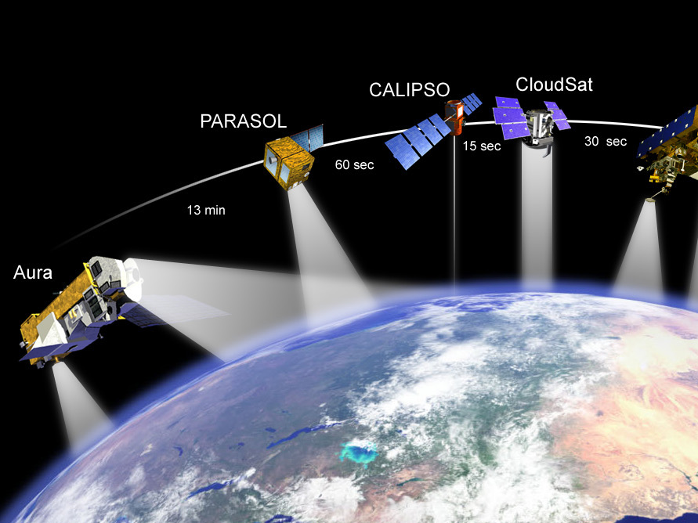
Open Sky Policy
Third Waves Democracy dan Human Rights (Free Flow of Information)
Space Treaty 1967 – Outerspace as common heritage of all mankind (international space)
GSO (GEO) Limited Resource on Equatorial Line
Direct Broadcasting by Satellite (DBS) Invasion --- May ‘84
Image: www.nasa.gov

Slide 4
Kedaulatan Negara
Cujus Est Solum Eust Ad Coelum -- Romawi
Jean Bodin (1576) sovereignty is: “la puissance absolue et perpetuelle d'une Republique” (the absolute and perpetual power of a Republic) -- The sovereign Prince is only accountable to God.
Sovereignty: absolute and undivided.

Slide 5
Penetrasi OTT Global
Globalization – economic purposes
Freedom of Expression
Net Neutrality (Tim Wu) : No blocking. No throttling. No paid prioritization.
Imbalances Regulation and Unfair Competition (No licence fee, no taxes, copyrights etc)
Private information for commercial gains.
Content and cultural problems.

Slide 6
Specific “Sovereign” Measures
Single Getway and Landing Rights Satellites
OTT must be within the regulatory framework
OTT as “Pay TV” (licencing, content regulation and replacement advertising).
Local Content Delivery Network (CDN) : improve quality and censorship undesirable content.
Toll-booth system, different services are priced differently.
Higher tax for local brand on OTT global and incentives vice versa.
Application of the downloader and the uploader theory.

Slide 7
Terima Kasih

