Slide 1
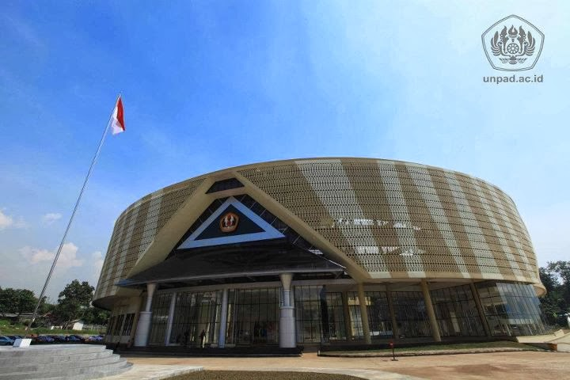

UNPAD MANDIRI UNGGUL & MASLAHAT
Transformative Education
and
Third Generation Higher Education
Tri Hanggono Achmad - Universitas Padjadjaran

Slide 2

One World One Earth

Slide 3
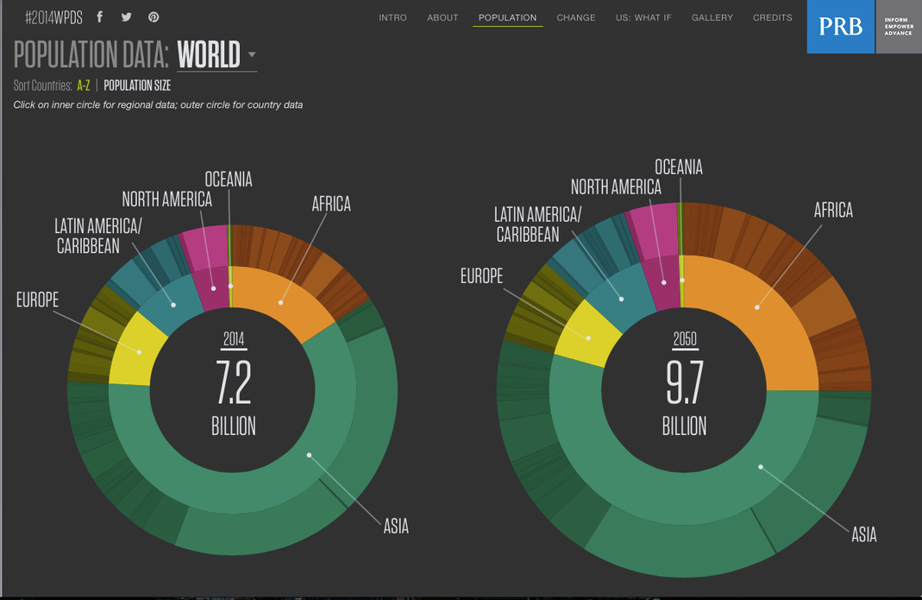
World Population Data
http://www.prb.org/wpds/2014/index.html

Slide 4
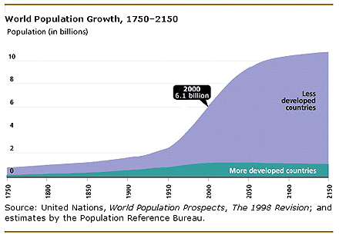
World Population Development

Slide 5
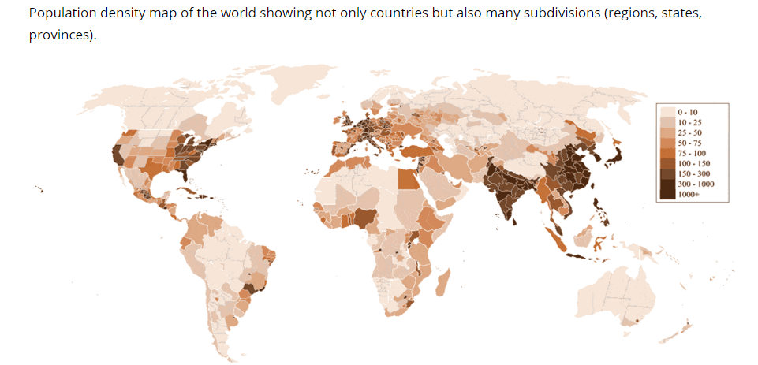
World Population Density (people/km²)
Notes:
Kepadatan penduduk

Slide 6
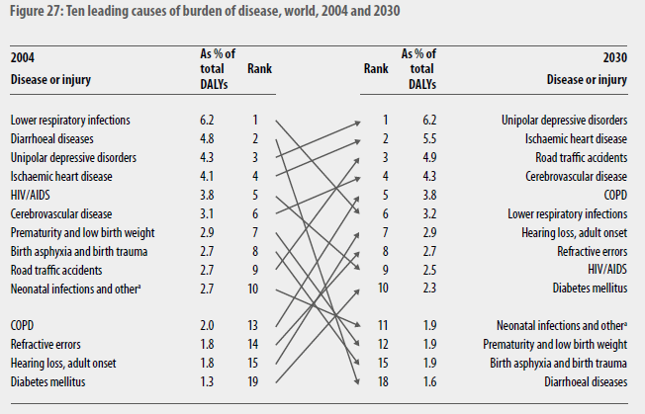
LEADING CAUSES OF GLOBAL BURDEN OF DISEASE (GBD), (WHO Global Burden of Disease 2004 Report)

Slide 7




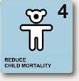

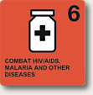


TARGET MDGs
Poverty & Hunger
Education
Gender
Chld Health
Maternal Health
Comm. Diseases
Environment
Partnership

Slide 8
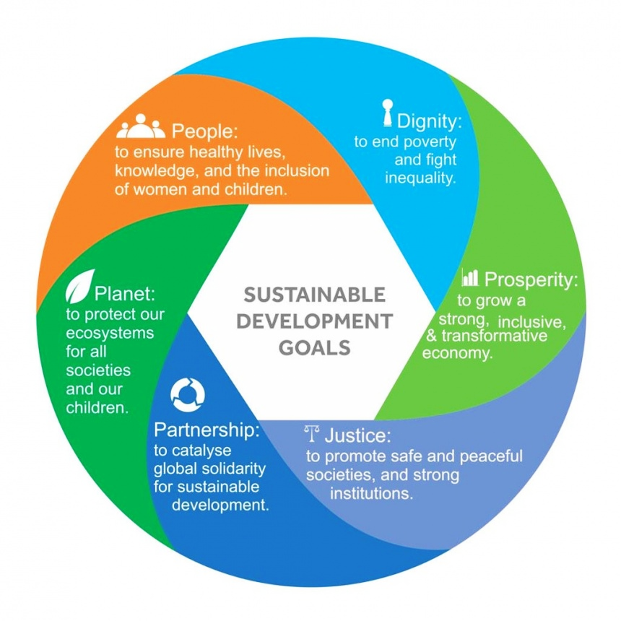
SUSTAINABLE DEVELOPMENT GOALS

Slide 9
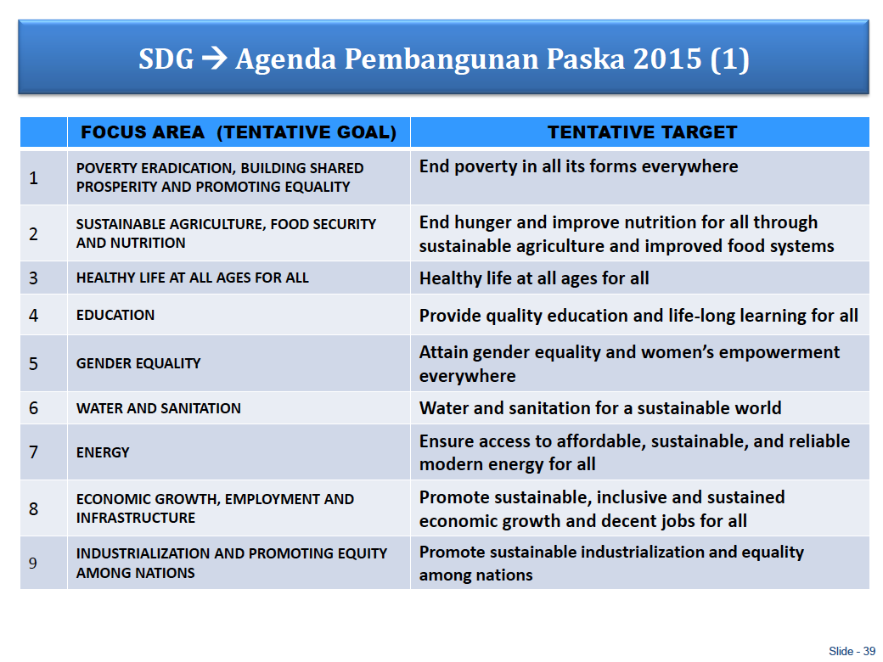

Slide 10
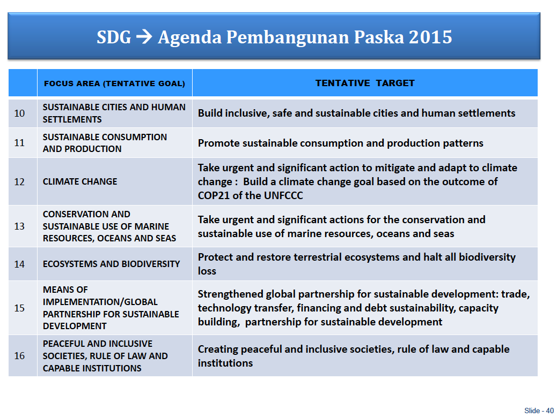

Slide 11
Pola Ilmiah Pokok (PIP)
Universitas Padjadjaran
“Bina mulia hukum dan lingkungan hidup
dalam pembangunan nasional”

Slide 12
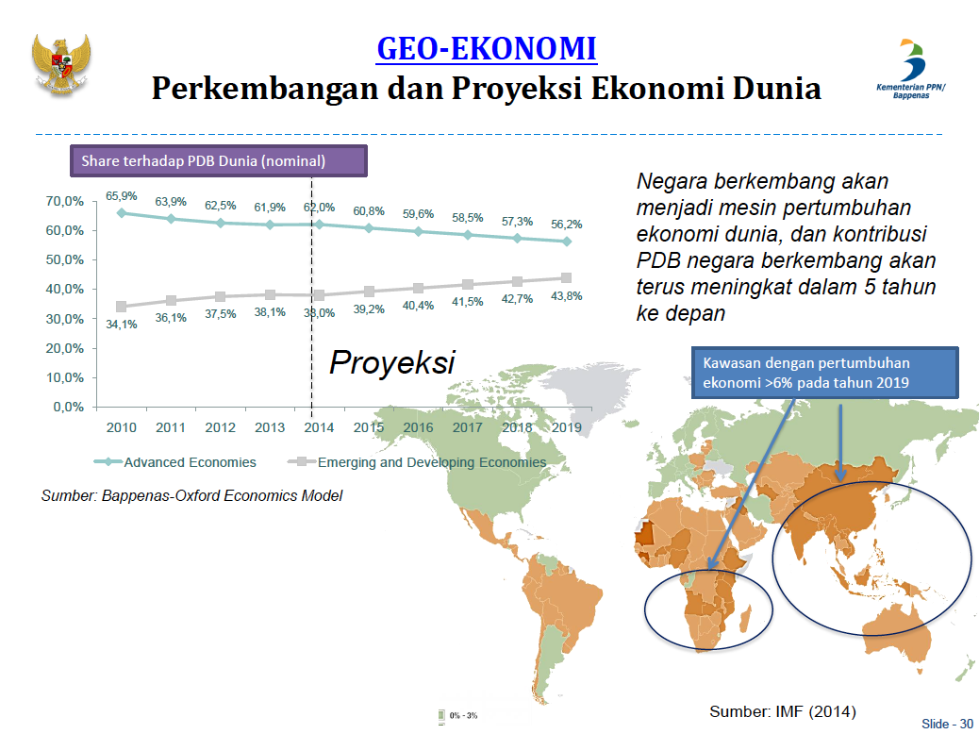
Sumber:
Kemenneg PPN/Bappenas, 2014

Slide 13
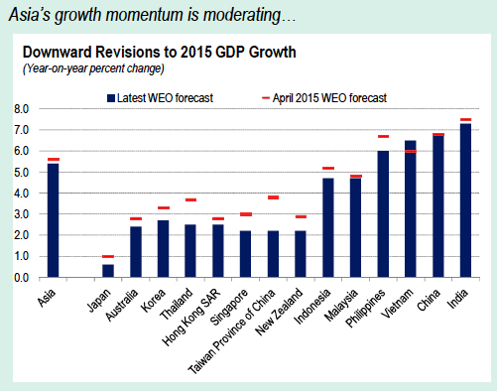
Sumber:
IMF Regional Economic Outlook – October 2015

Slide 14
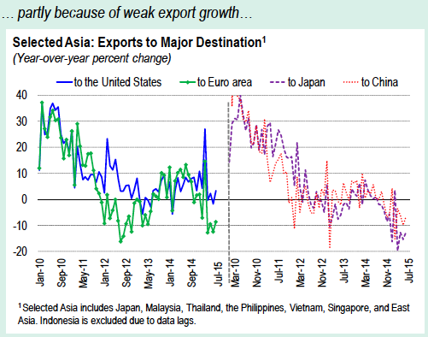
Sumber:
IMF Regional Economic Outlook – October 2015

Slide 15
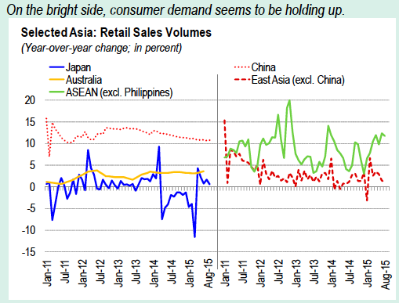
Sumber:
IMF Regional Economic Outlook – October 2015

Slide 16
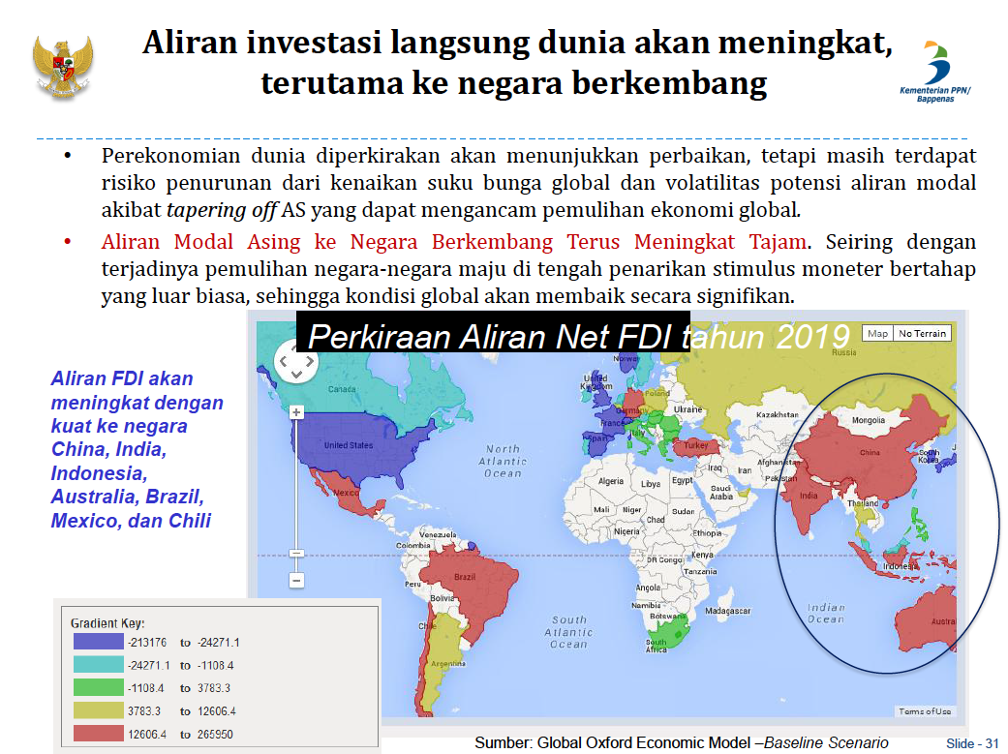
Sumber: Kemenneg PPN/Bappenas, 2014

Slide 17
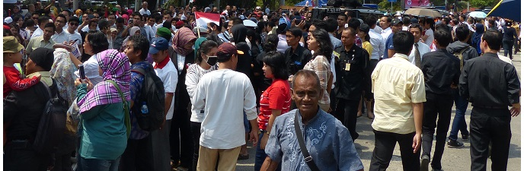
Berbagai permalasahan & tantangan
Yang dihadapi oleh Indonesia

Slide 18
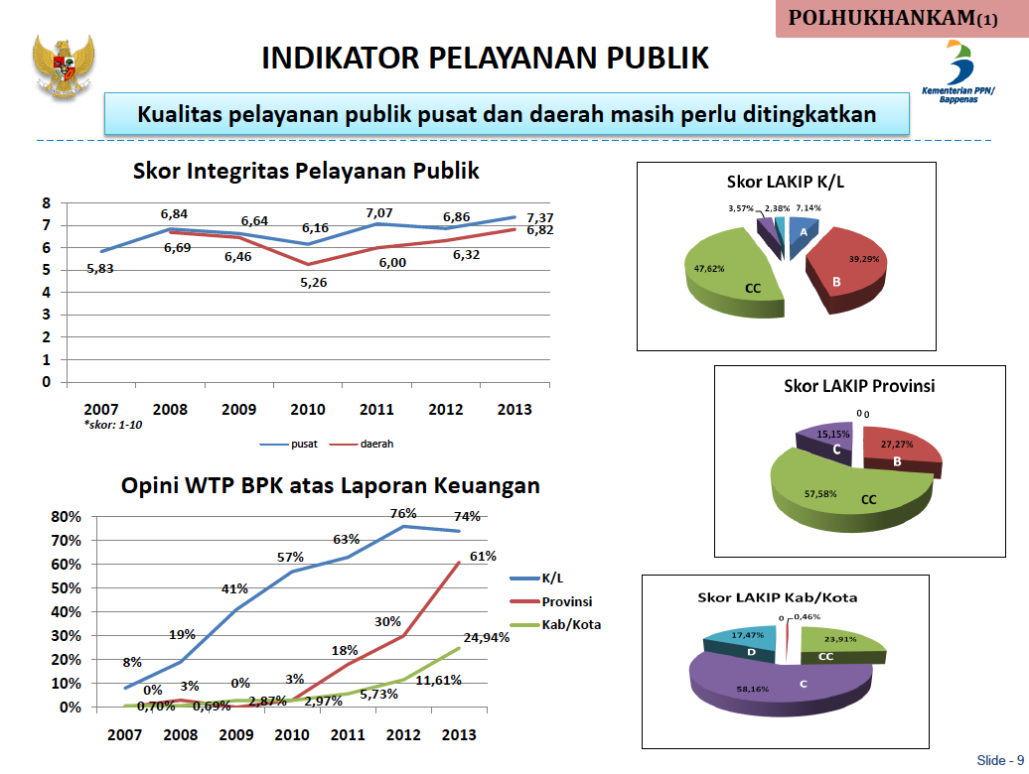
Sumber: Kemenneg PPN/Bappenas, 2014

Slide 19
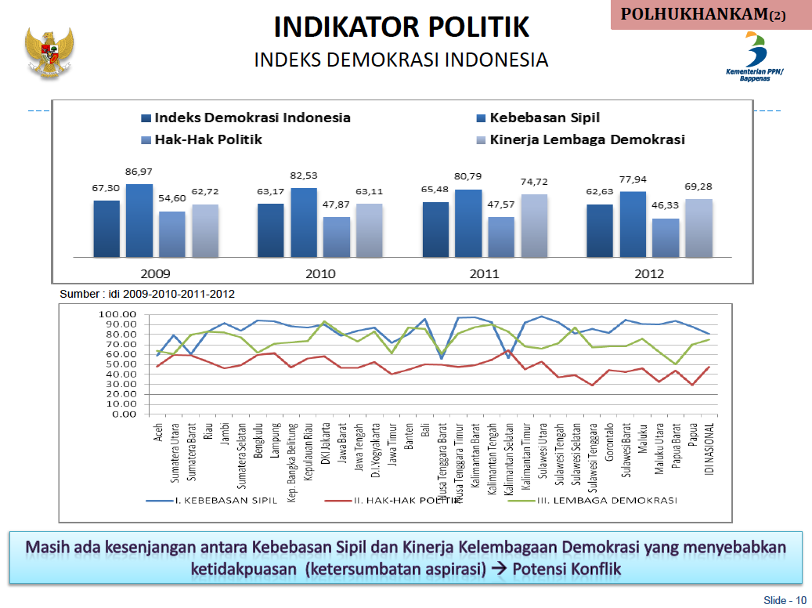
Sumber: Kemenneg PPN/Bappenas, 2014

Slide 20
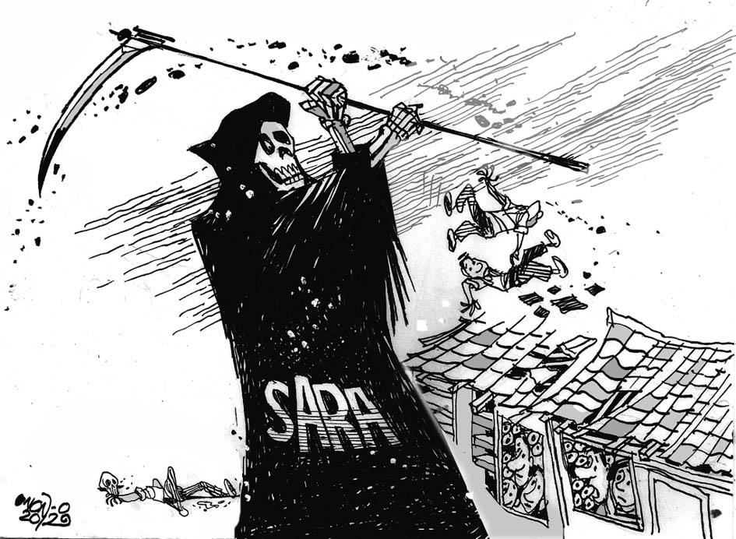
KONFLIK SARA
Masih terjadi perusakan rumah ibadah, terorisme,
pertikaian antar suku, bahkan saling ejek antar agama di dunia maya. Jika masalah ini dibiarkan terjadi, maka akan terjadi disintegrasi bangsa dan sangat berbahaya bagi
kedaulatan bangsa.

Slide 21
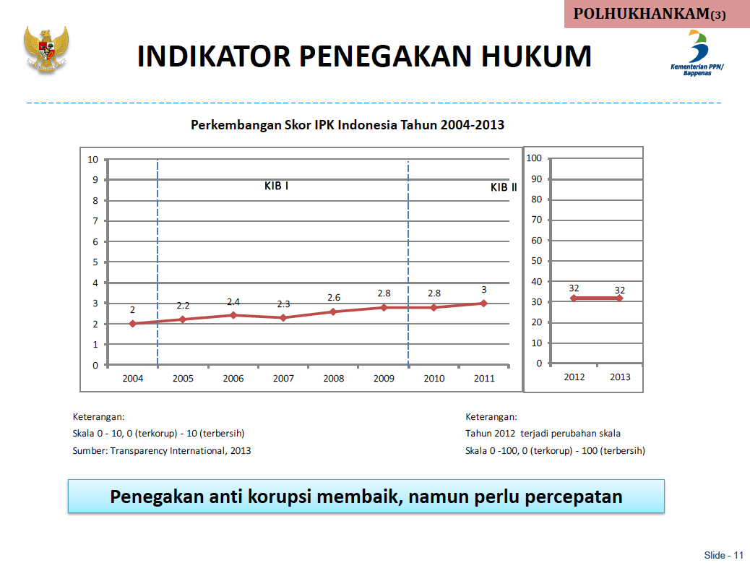
Sumber: Kemenneg PPN/Bappenas, 2014

Slide 22
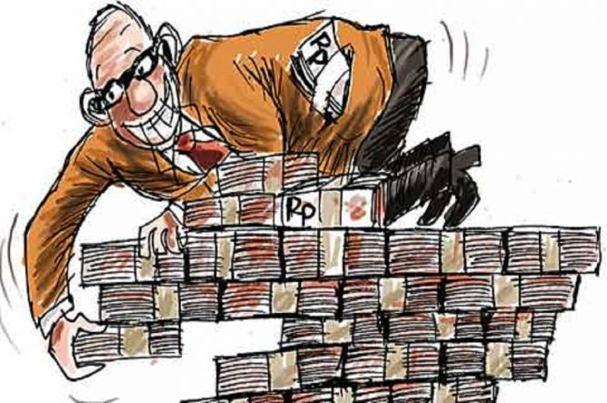
Korupsi
Total kerugian keuangan negara akibat tindak pidana korupsi sepanjang 2015 mencapai Rp31,077 triliun. Pelakunya mulai dari pejabat atau pegawai pemda/kementerian, direktur dan komisaris pegawai swasta, kepala dinas, anggota DPR/DPRD, sampai camat dan kepala desa.

Slide 23
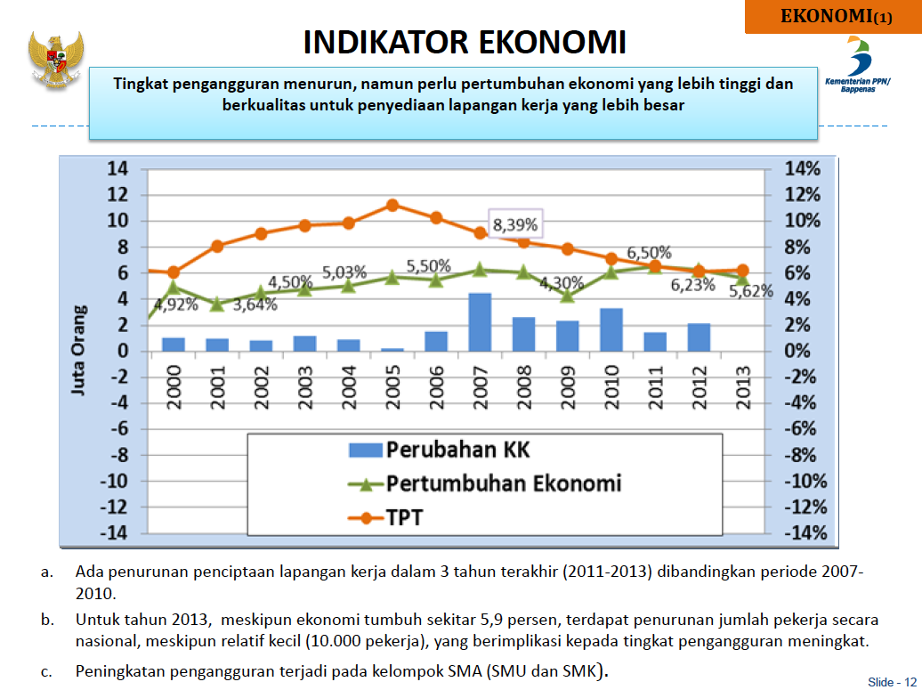
Sumber: Kemenneg PPN/Bappenas, 2014

Slide 24
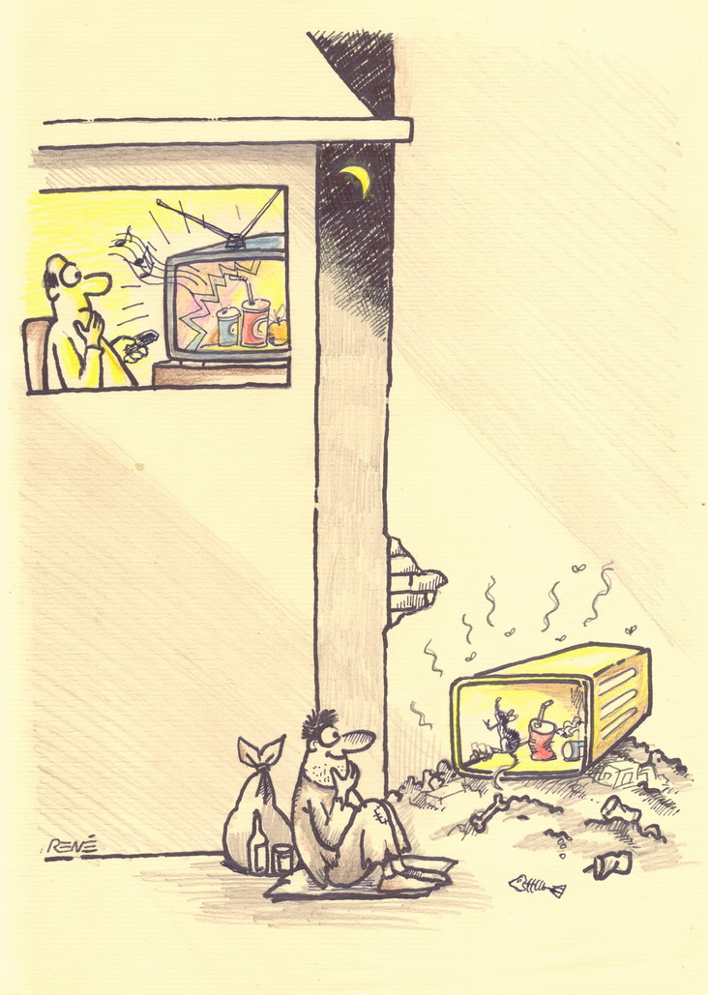
Pengangguran &
Kesenjangan Sosial

Slide 25
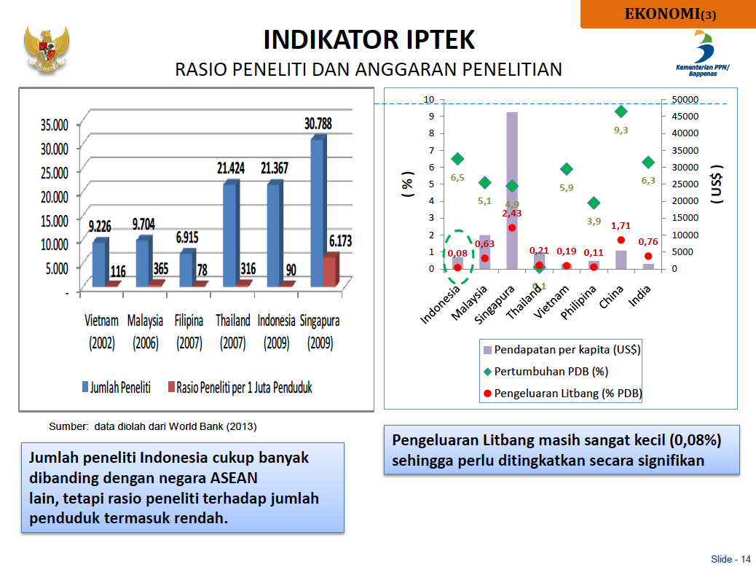
Sumber: Kemenneg PPN/Bappenas, 2014

Slide 26
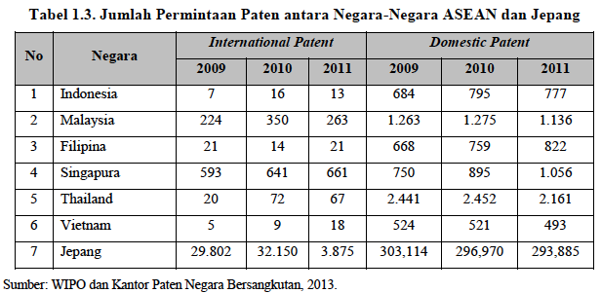
Sumber: Kemenneg PPN/Bappenas, 2014

Slide 27
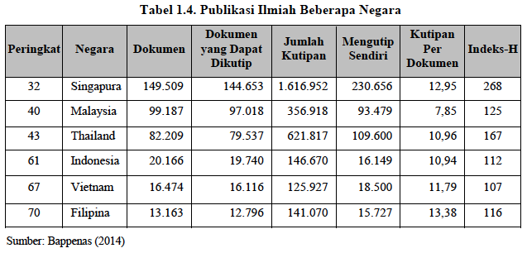
Sumber: Kemenneg PPN/Bappenas, 2014

Slide 28
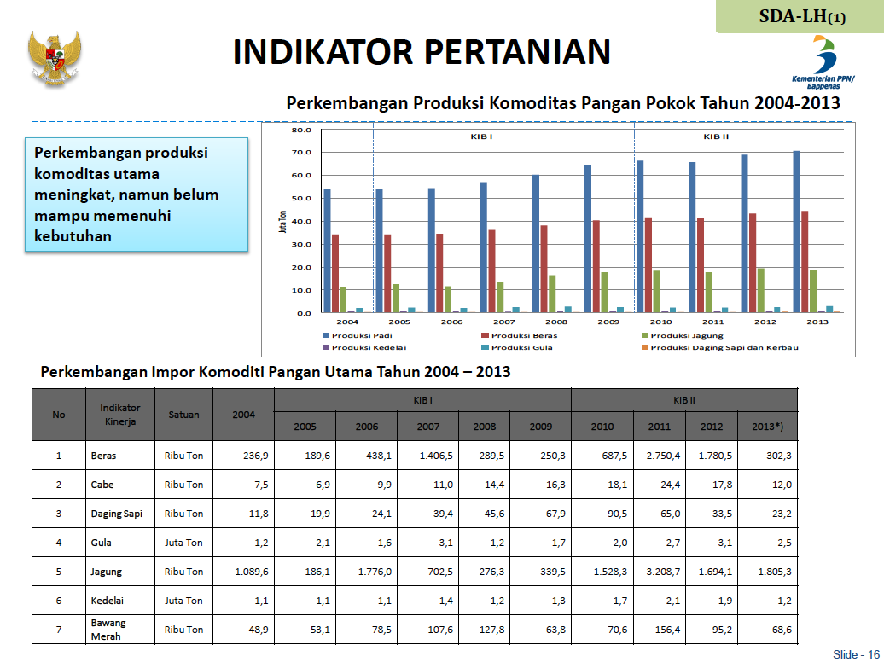
Sumber: Kemenneg PPN/Bappenas, 2014

Slide 29
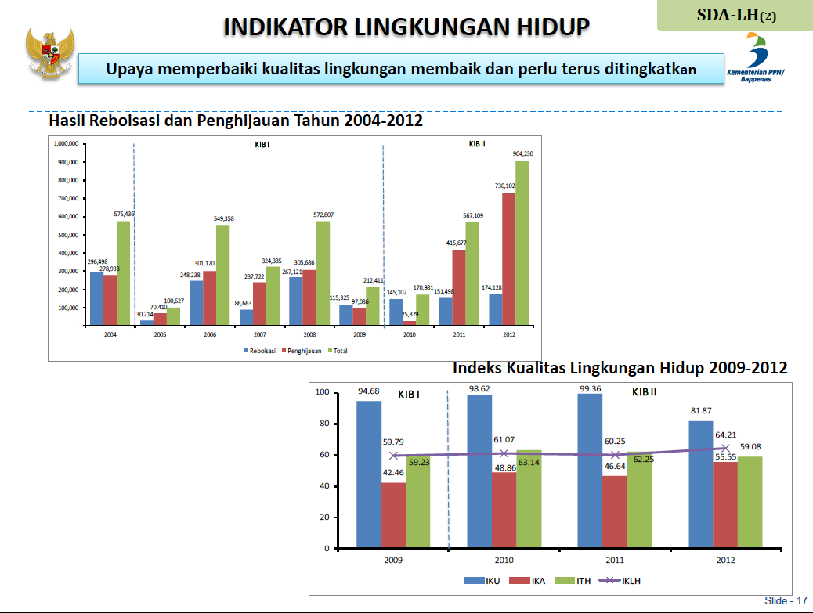
Sumber: Kemenneg PPN/Bappenas, 2014

Slide 30
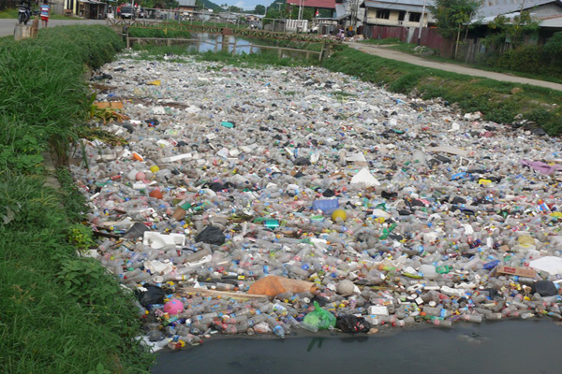
Kerusakan Lingkungan
Kerusakan lingkungan di Indonesia sudah semakin parah. Penebangan hutan secara ilegal, pembuangan sampah dan limbah pabrik ke sungai, alih fungsi lahan, dan penggunaan kendaraan bermotor yang semakin meningkat.

Slide 31
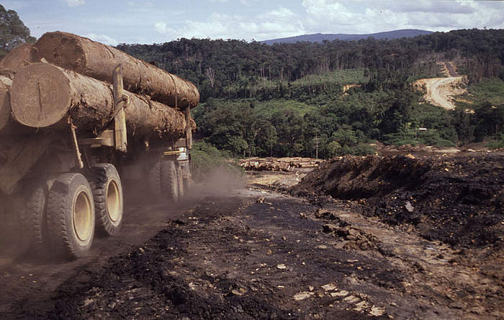
Pengelolaan Sumber Daya Alam yang Buruk
Sumber daya agraris, tambang, hutan, laut, dan lainnya tidak dikelola maksimal, dirusak, dan diekploitasi oleh bangsa sendiri ataupun negara lain

Slide 32
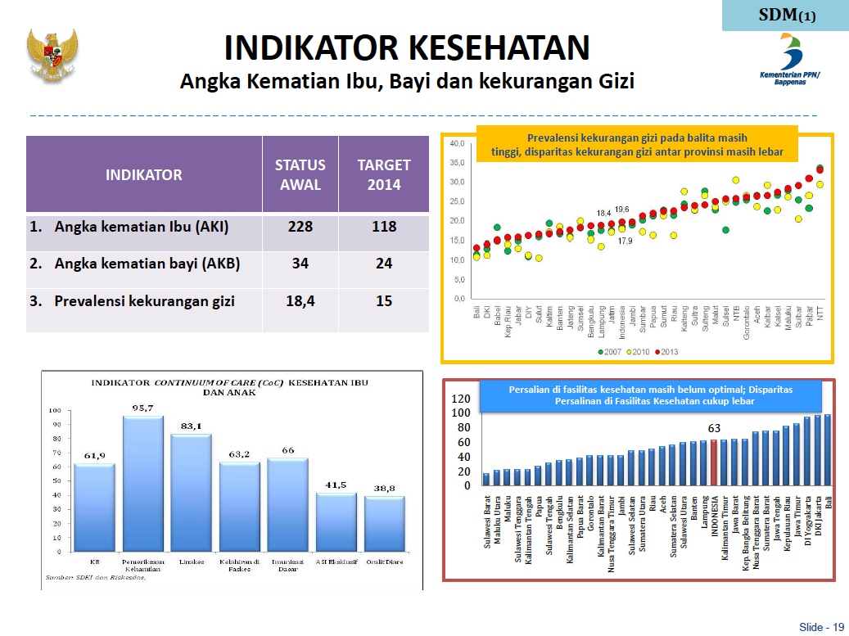
Sumber: Kemenneg PPN/Bappenas, 2014

Slide 33
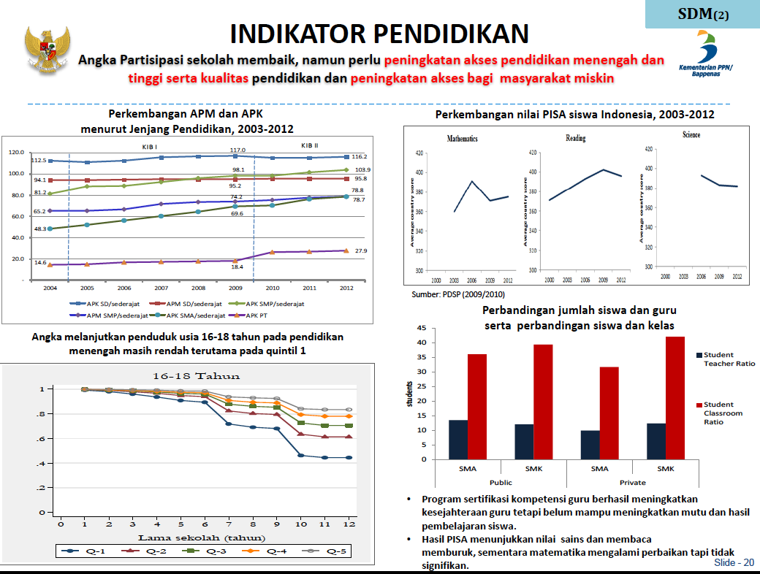
Sumber: Kemenneg PPN/Bappenas, 2014

Slide 34

KRISIS BUDAYA
KRISIS KARAKTER
KRISIS BUDI LUHUR ?

Slide 35
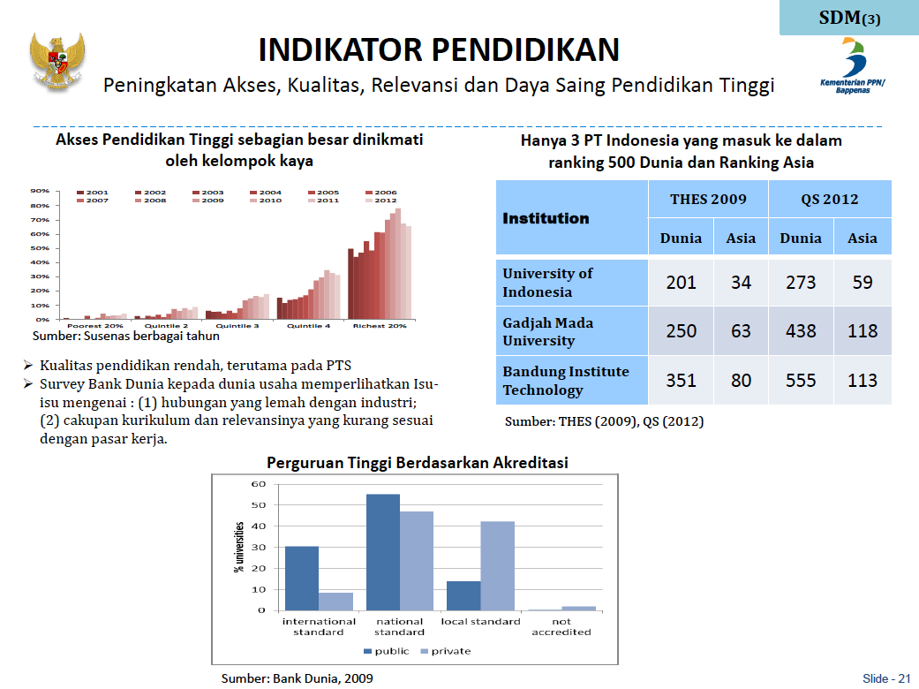
Sumber: Kemenneg PPN/Bappenas, 2014

Slide 36
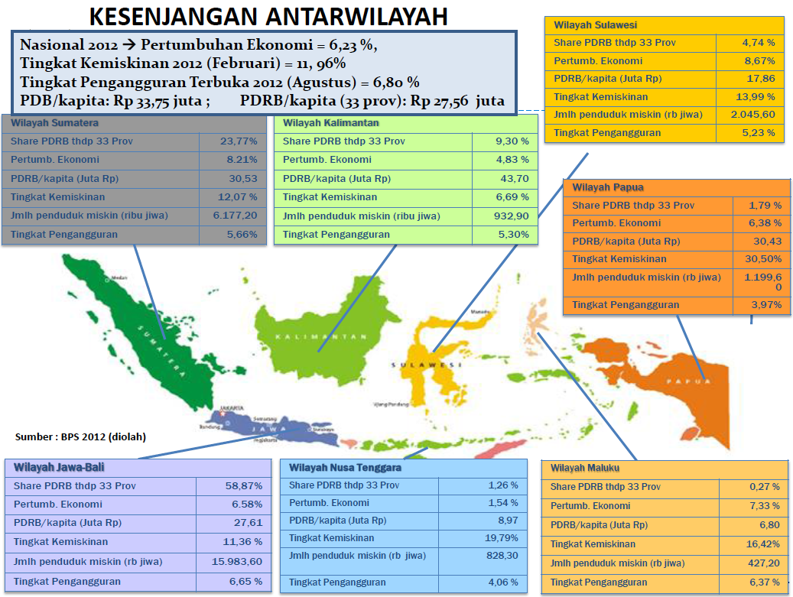

Slide 37
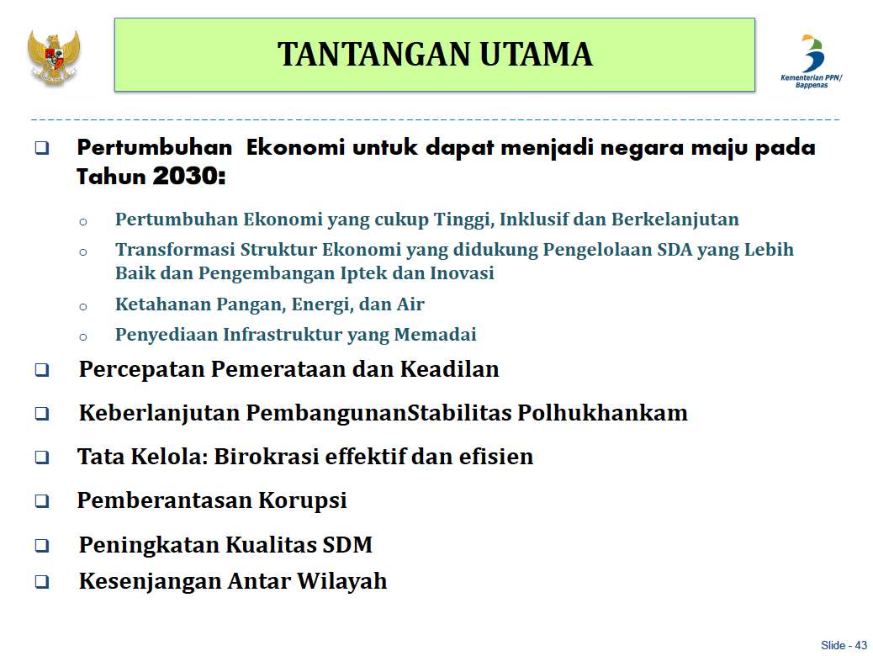
Sumber: Kemenneg PPN/Bappenas, 2014

Slide 38
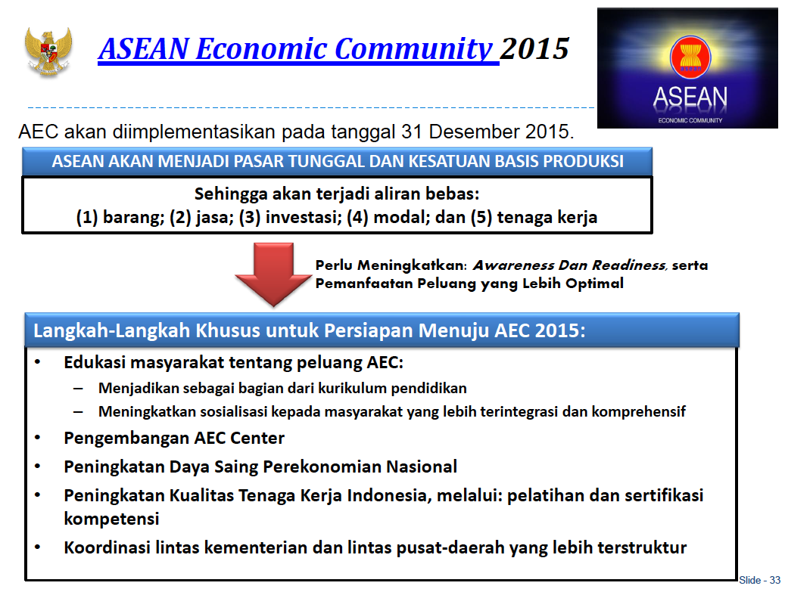

Slide 39
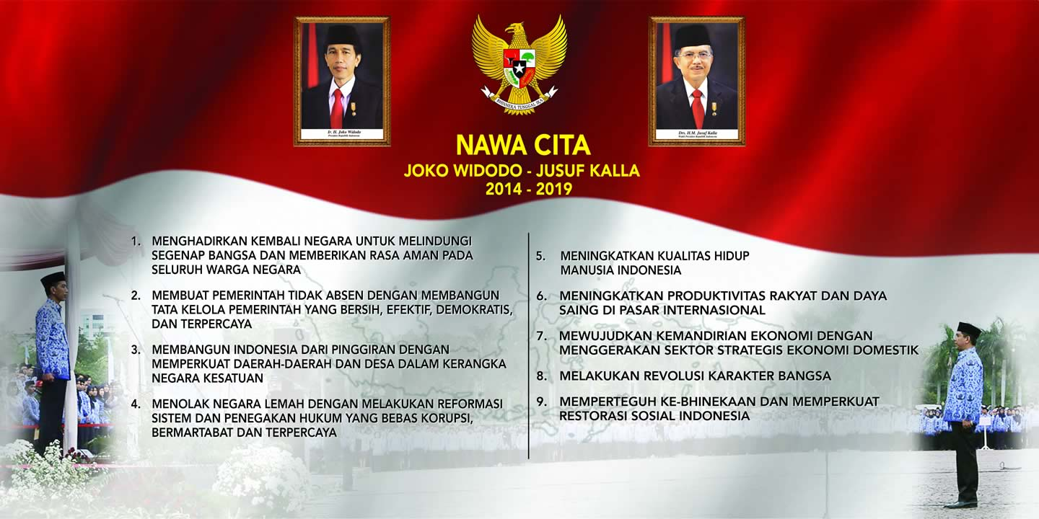
Nawa Cita

Slide 40
Emerging Challenges to
Higher Education System
Environment & demographic transitions
Technological innovation
Higher
Education System
Professional differentiation
Population demands

Slide 41
Higher education has not kept pace
with these challenges,
largely because of fragmented, outdated,
and static curricula
that produce ill-equipped graduates.

Slide 42
Global outlook :
multiprofessional perspective and systems approach.
This comprehensive framework considers
the connections between education and systems in the society.
It is centred on people as co-producers and as drivers
of needs and demands in both systems.
By interaction through the labour market,
the provision of educational services
generates the supply of an educated workforce
to meet the demand for professionals
to work in the system.
To have a positive effect on program outcomes,
the professional education subsystem
must design new instructional and institutional strategies.

Slide 43


“ ….university encompasses a ‘third-mission’ of economic development in addition to research and teaching.” Readings (1996)
ULTIMATE CONTRIBUTION
PEOPLE EXPECTATION
MAIN PERFORM. INDICATOR
INNOVATING TO DEVELOP
LOCAL AND NATIONAL
COMPETITIVENESS
AGENT OF
ECONOMIC
DEVELOPMENT
# INNOVATION,
# EMPLOYMENT
# INDUSTRY
# Rp GENERATED
TRANSFERING CULTURE,
KNOWLEDGE, TECHNOLOGY TO
SOCIETY AND INDUSTRY
AGENT OF
CULTURE, KNOWLEDGE,
TECHNOLOGY
TRANSFER
# C,K,T TRANSFERED
# INDUSTRY AND COMMUNITY
RESEARCHING BASIC
AND APPLICATIVE
PROBLEMS
# PUBLICATION
# PATENT
# CITATION
UNIVERSITY RANKING
AGENT OF
RESERACH
EDUCATING
PEOPLE
AGENT OF EDUCATION
# GRADUATE
EMPLOYABILITY
WAITING TIME
Sumber: Kemristekdikti, 2015

Slide 44
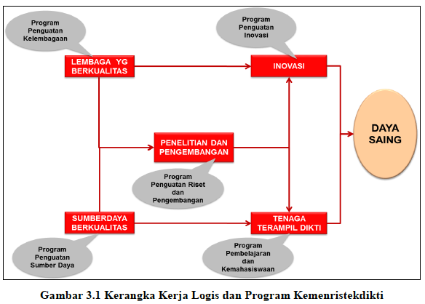
Sumber: Kemristekdikti, 2015

Slide 45
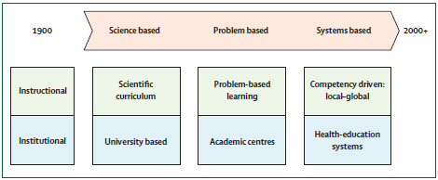
Three generations of reform
(Frenk et al, 2010)

Slide 46
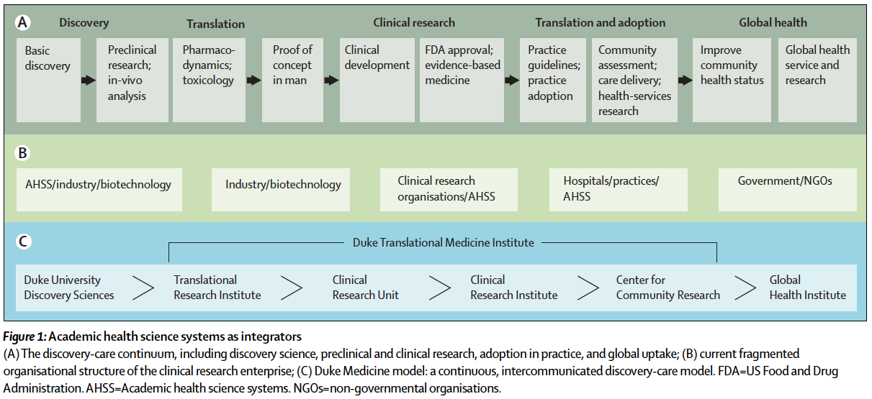
The role of academic health science systems in the transformation of medicine
(Dzau et al., 2010)

Slide 47
Three generation of Higher Education
storehouse of knowledge
knowledge factory
knowledge hub

Slide 48
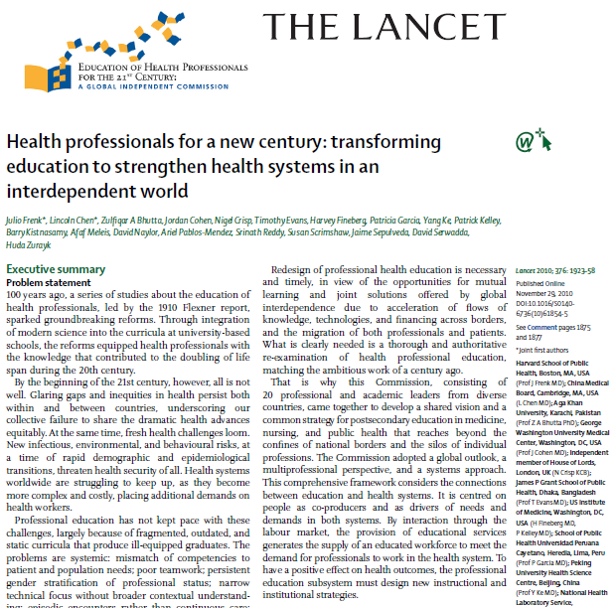

Slide 49
Realization of this vision will require
a series of instructional and institutional reforms,
which should be guided by two proposed outcomes:
transformative learning
and interdependence in education.

Slide 50
Transformative learning :
the highest of three successive levels,
moving from informative to formative to transformative learning.
Informative learning is about acquiring knowledge and skills;
its purpose is to produce experts.
Formative learning is about socialising students around values;
its purpose is to produce professionals.
Transformative learning is about developing leadership attributes; its purpose is to produce enlightened change agents.

Slide 51
Effective education builds each level on the previous one.
As a valued outcome,
transformative learning involves three fundamental shifts:
* from fact memorisation to searching, analysis,
and synthesis of information for decision making;
* from seeking professional credentials
to achieving core competencies
for effective teamwork in society systems;
* from non-critical adoption of educational models
to creative adaptation of global resources
to address local priorities.

Slide 52
Interdependence is a key element in a systems approach
because it underscores the ways in which
various components interact with each other.
As a desirable outcome, interdependence in education also involves three fundamental shifts:
* from isolated to harmonised education and society systems;
* from standalone institutions to networks, alliances, and consortia;
* from inward-looking institutional preoccupations
to harnessing global flows of educational content,
teaching resources, and innovations.

Slide 53
Transformative learning
is the proposed outcome of instructional reforms.
Interdependence in education
should result from institutional reforms.

Slide 54
HE Impact
Masyarakat Sejahtera
Pengembangan Keilmuan
Pengajaran

Slide 55
3 Paradigms of Reform
Re-engineering Quality Culture
Standards of Education
Standards of Competencies
Academic paper of Education System
for each profession
Quality Assurance System
Public-Private Partnership
Inter-professional Collaboration
Accreditation System
Competency Examination System
Indonesian Qualification Framework
Partnership among professions :
education to services
Partnership between government, professionals community & independent agencies
agent for sustainable development
Independent agency
for accreditation & competency examination

Slide 56
Change Management Strategy
KEY CHALLENGE : Communication Gap
Key method
Well-designed Communication System
Commitment from Professional Community
Trustworthy
ICT
System
Key values
Key actor

Slide 57

KEY SUCCESS FACTOR :
STAKEHOLDERS’ ENGAGEMENT

Slide 58
Pra kondisi yang diperlukan
Academic Atmosphere
Quality of Human Capitals
Facilities
Partnership and Collaboration

Slide 59



Tri H. Achmad - MERDU
LEADERSHIP /
ORGANISATION
INFRASTRUCTURE
QA / ASSESSMENT
H R D
IT SYSTEM
FINANCIAL
CURRICULUM
Faculty of Medicine - Universitas Padjadjaran – www.fk.unpad.ac.id

Slide 60
Tri H. Achmad
Faculty development
should be driven
by clearly identified educational needs
and must be a continuous process

Slide 61
Tri H. Achmad
There is no curriculum development,
there is only staff development
Harden, 2009

Slide 62
Recruitment of academics
Tri H. Achmad
Enhancement of the existing faculties
  Increase of PhD holders
  Concentration of talents
Invitation of expatriates
  Internationalization of institutions
  Critical mass of national academics
Attraction of returnees
  The issue of “brain drain”

Slide 63
Lives in Education
International Exchange
Visits to Rural, Deprived Communities
Community Services/NGO
Internship, Placement, Mentorship
Design, Music, Drama, Sports
Executives of Organisations
Student Activities/Halls
Study
Classes

Slide 64
Learning Experiences
Learning across Cultures
Learning to Care
Learning to Serve
Creativity Learning
Workplace Learning
Leadership Learning
Alternative Learning
Academic
Knowledge
Classes

Slide 65
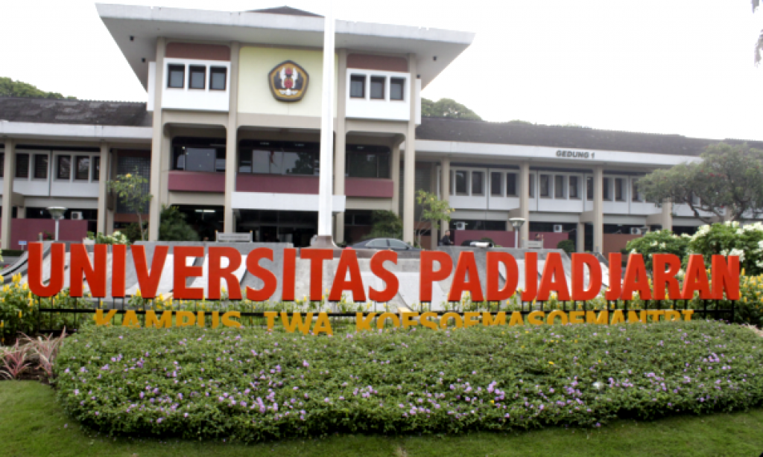
A Great Institution
Transforms The Students

Slide 66
Reforming Governance
Tri H. Achmad - MERDU
Identification of Champions
Importance of vision building
University autonomy vis-à-vis accountability
Notion of Institutional Advancement

Slide 67
Tri H. Achmad
We are not just
doing more and better of
what we have been doing.
We are building
a different bussiness system!

Slide 68
A different paradigm
Tri H. Achmad - MERDU
Public funding
No money, no plan
Budget cut, activity reduction
Look for small money
Ask for money when poor
Funding is the limit
Doing what we did
Steady progress
Appropriation
Advancement
No vision, no money
Great vision, big money
Look for big money
Ask for money when strong
Sky is the limit
Scaling new planes
Advancement
Partnership

Slide 69
Where to Begin?
Tri H. Achmad
Build committment & leadership
Facilitate, empower & enable
Critically self-evaluate program
(start from what we have)
Request outside evaluation
Decide on a vision
Continuing Quality Improvement

Slide 70
Untuk terwujudnya hal di atas diperlukan “Academic Policies”

Slide 72

TEACHING AND COMMUNITY SERVICES BASED ON RESEARCH
Capacity Building (HRD)
Kesejahteraan masyarakat dan Pengembangan akademik
Organization & Management
(SOP & ICT)
Infrastructure Supporting Facility
RESEARCH UNIVERSITY
Scientific atmosphere.
& Research Culture
Towards Third Generation University

Slide 73
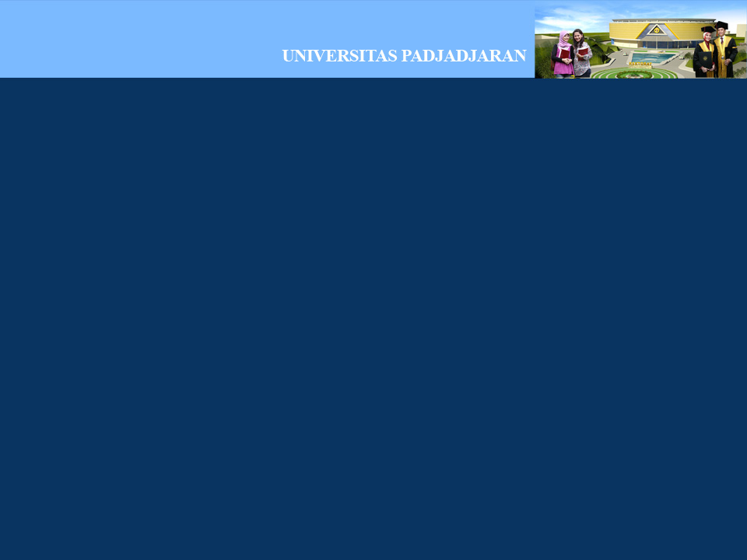
ARAH KEBIJAKAN UTAMA
Membangun kemandirian sumberdaya melalui peningkatan kemitraan
Mewujudkan keunggulan akademik transdisipliner melalui pengarusutamaan riset dan optimasi potensi wilayah dalam konteks global
Mentransformasikan proses akademik yang berorientasi pada maslahat pembangunan yang berkelanjutan
Mewujudkan tata kelola korporasi akademik yang sinergi, berintegritas, akuntabel dan produktif (SIAP)
Menerapkan nilai-nilai adiluhung budaya Sunda pada kehidupan akademik dalam konteks peradaban umat manusia

Slide 74
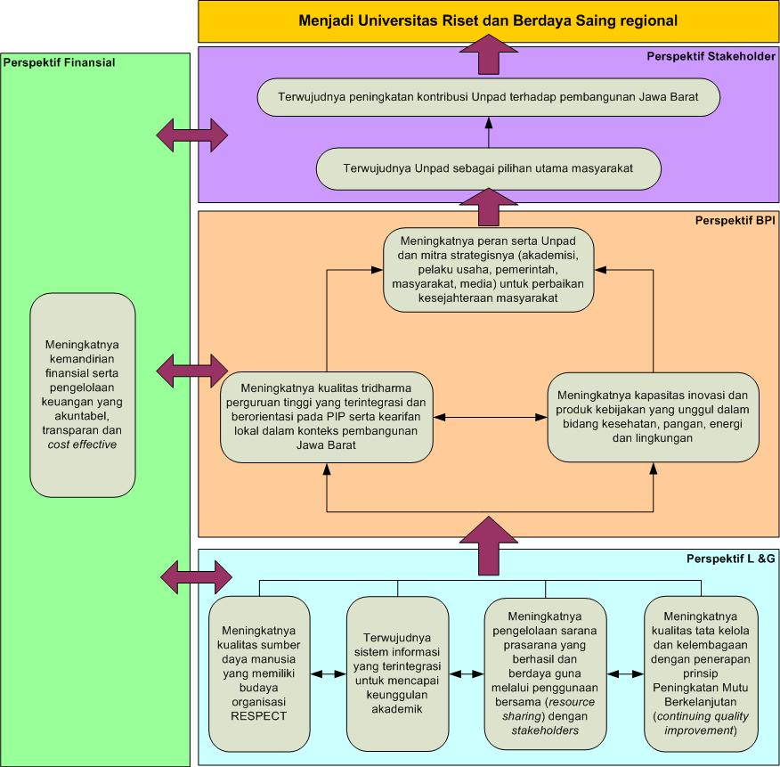
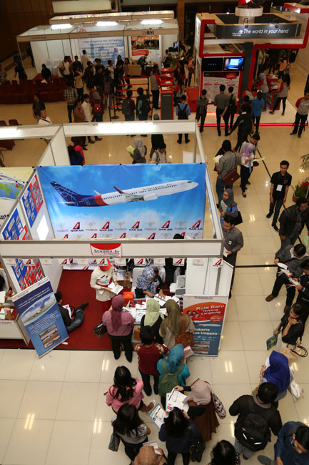
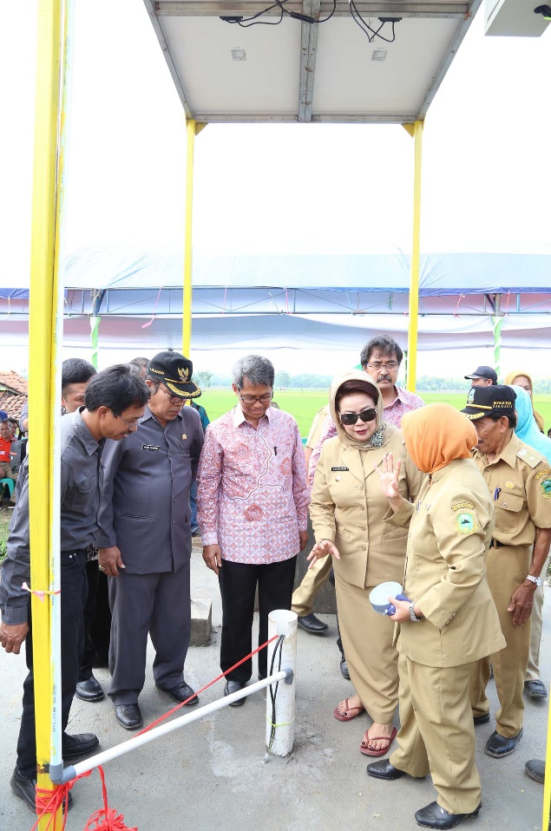
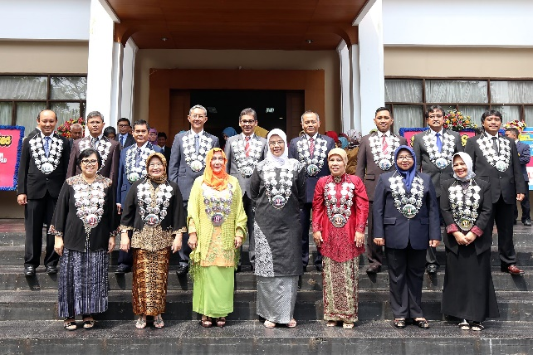
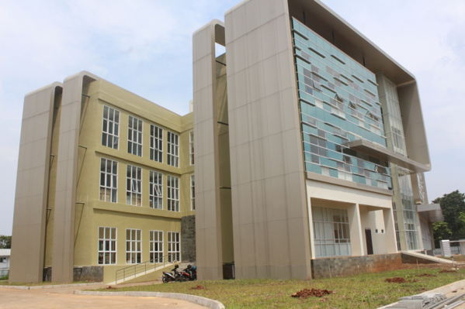
Sasaran strategis
2019
2018
2017
2016
2015

Slide 75
THE PENTAHELIX STRATEGY
GOVERNMENT
BUSINESS
ACADEMIC
COMMUNITY
MEDIA

Slide 76
ORGAN UNPAD
REKTOR
MAJELIS WALI AMANAT
SENAT AKADEMIK
UNPAD
PP No. 51 Tahun 2015
tentang Statuta Unpad

Slide 77
UNPAD TRANSFORMATIVE TRIANGLE
UNPAD
KAMPUS DIPATI UKUR
From West Java for the Nation to the World
KAMPUS ARJASARI
Science & Tech Translation & Regional Development
KAMPUS JATINANGOR
Excellent R & D

Slide 78
OPERASIONALISASI
IKU/IKK
PROGRAM
Prodi berakreditasi unggul
Hibah Unggulan Prodi (HUPS)
Lulusan tepat waktu dan masa tunggu kurang dari 4 bulan
Sistem Renumerasi
Dosen dan mahasiswa melakukan penelitian
Publikasi penelitian dalam jurnal terindex dan forum
Sistem korporasi akademik
Jumlah penelitian untuk komersialisasi dan dosen melakukan pengabdian
Penta Helix (ABCGM)
Jumlah profesor
SOTK: fleksibel & akomodatif thd diversitas
Persentase kualifikasi akademik dosen
Rangking QS star dan implementasi siap
Academic Leadership Grant
(Program 1-1-6)
Presentase pendapatan PNBP per total anggaran
Office for Academic Enterprise
Presentasi penerimaan dana PPM

Slide 79


REGIONAL
Education System
Development Program in West Java
NATIONAL
GLOBAL
Supply
Needs
Benefit for the people in District/City of West Java Province
through partnerships in education, research and community engagement as “Tridharma” of Higher Education

Slide 80
10 Common Goals of West Java 2013-2018
10
Common
Goals
1
Access and Quality of Education
2
Access and Quality of Health Services
3 Infrastructure, Energy and Water
4
Agriculture Economics
5
Non-agriculture Economics
6
Natural Resources, Environment, Disaster
7
Arts and Culture, Tourism, Youth and Sports
8
Family Resilience and Population
9
Poverty and Security
10
Government Modernization and Rural Development

Slide 81
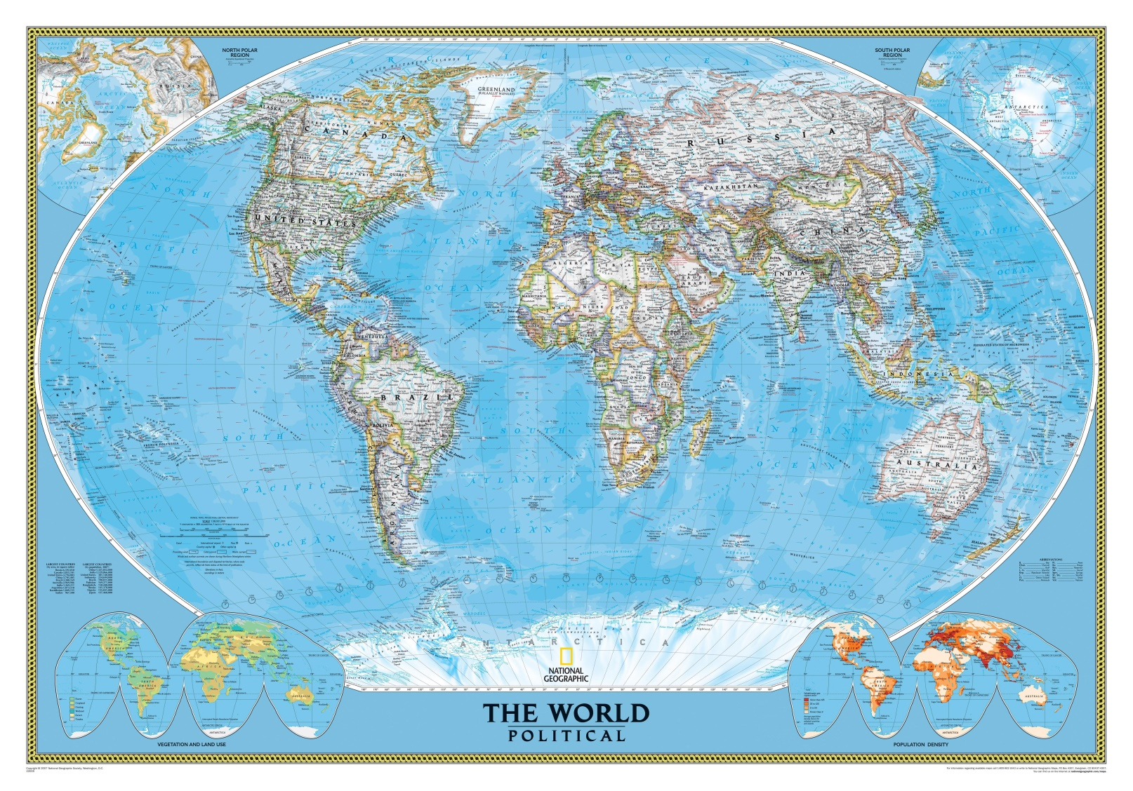
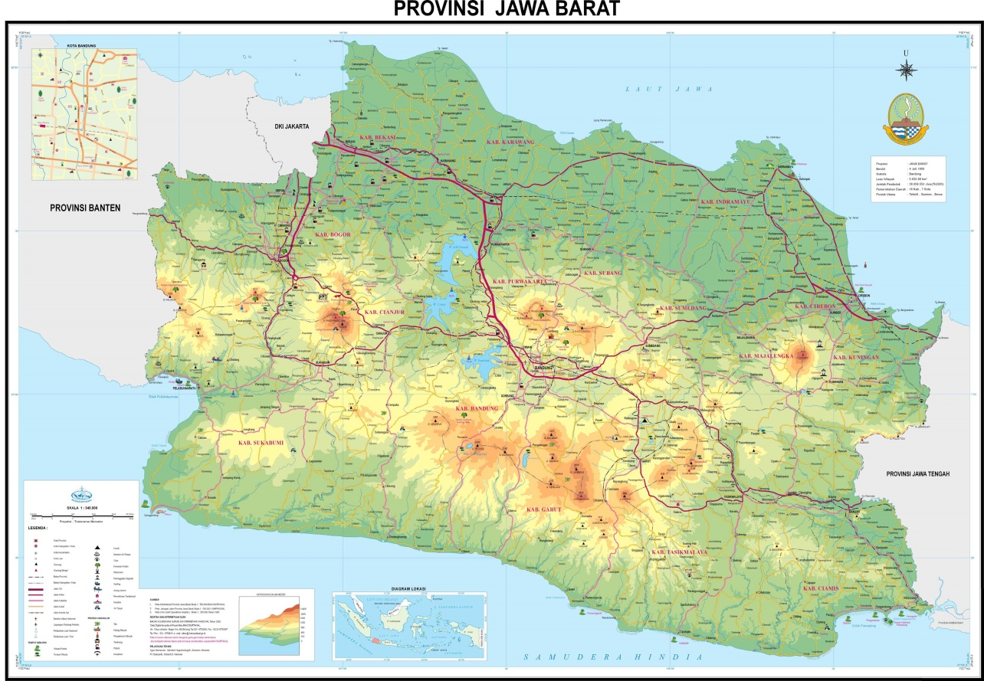
Unpad Contribution: from West Java for Indonesia to the World through sustainable development

Slide 82
Tri H. Achmad
Society has changed
and is changing quickly …

Slide 83
MORAL MOVEMENT
from “routine to quality”
STRENGTHENING QUALITY OF
HIGHER EDUCATION
KPI
from “me” to “we”
from “ignorance” to “care”
abolish geographical challenges by empowerment of ICT
Sustainable prosperity of the society

Slide 84

Together We Can
Unpad ngahiji
Unpad kahiji
Hatur nuhun
HPEQ DIKTI

