Slide 1

SDGs and the Global Sustainability Agenda
Prof. Dr. Armida S. Alisjahbana
Universitas Padjadjaran
Indonesian National Academy of Sciences
Sustainability Science Symposium
Bandung, September 20, 2016

Slide 2
Outline
SDGs Once Again
The Economic, Social and Environmental Pillars
The Importance of Governance and Institution
Seeking an Integrated Approach and Strategy
Concluding Remarks

Slide 3
1. SDGs Once Again
UN Resolution no 70/1 adopted by 193 countries in 2015 → “Transforming Our World: the 2030 Agenda for Sustainable Development”
MDGs Plus, based on Agenda 21 and Global Consultative Processes
Shared Vision:
  Comprehensive (Economic, Social and Environmental Pillars Plus Governance)
  Thematic (17 Goals)
  Holistic and Integrated
  Inclusive (no one left behind)
  Partnership (all development stakeholders)

Slide 4
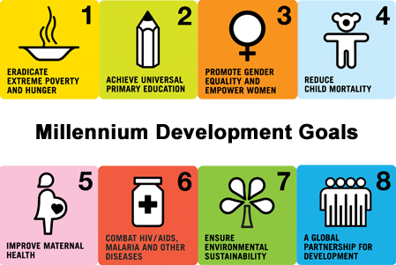
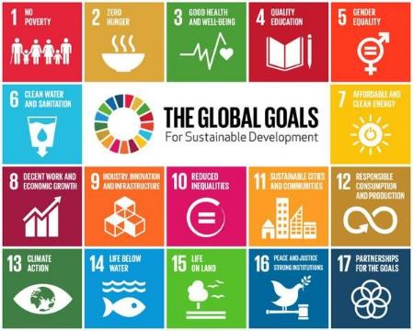
From MDGs to SDGs: from 8 to 17 goals
Notes:
SDGs akan dijalankan oleh negara-negara maju dan berkembang, termasuk Indonesia, untuk 15 tahun ke depan. Kesepakatan untuk menjalankan SDGs dilakukan oleh para pemimpin tiap negara (dan untuk Indonesia oleh Wakil Presiden Jusuf Kalla) di kantor pusat PBB (New York) pada tanggal 25-27 September 2015 pada saat Sidang Majelis Umum PBB.

Slide 5





















From MDGs to SDGs:
An Ambitious Transformation
From 60 indicators to 230 indicators (UNStats, March 2016)

Slide 6
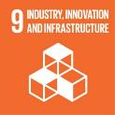
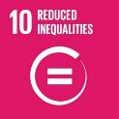
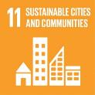

New goals in SDGS
SDGs:
Agenda 21
OWD on SDGs
Other consultative processes
UN GA Deliberations
→ Proposed Goals and Targets are as much as results of Global Political Processes

Slide 7
2. The Economic, Social and Environmental Pillars
Based on Sachs, 2012, 2015a, 2015b and ADB, 2011:
Shared focus and urgency on economic, social and environmental goals to address global sustainability issues
Global Sustainability Issues:
Environmental and Climate Change Issues:
  Global economic growth with its consequences on Planetary Boundaries (Anthropocene – human driven age of the planet)
  Global and local pressures → carbon, nitrogen, water cycles
  Many overlapping crises of environmental sustainability: climate change, the acidification of the oceans, unsustainable use of natural resources (renewable and non-renewable)

Slide 8
  Unsustainable conversion of forests → loss of biodiversity
  Unsustainable depletion of key fossil resources
  Impact on food production
Population Issues:
  Population growth (9 billion in 2035) – uneven population growth and issues
  China and India population size and growth
  Impact on global food demand and change in consumption pattern
Social Inclusion Issues:
  Inequality across and within countries
  Caused by low human capital (education, health, skill level)
  Socio-economic factors on inequality
  Gender bias

Slide 9
  Youth – youth unemployment
  Access and availability of good jobs
Economic Issues:
  Almost all developing (including least developed) countries by 2030 will become middle income countries
  Classic sources of economic growth: Capital, Labor and Productivity (technological progress)
  New sources of transformative growth: young and productive population, the growing middle class, ICT, Climate Change and Environmental Issues
  Could further enhance inequality if not properly addressed

Slide 10
3. The Importance of Governance and Institution
Achievement of SDGs will depend on the successful implementation of all three pillars
Need concerted global efforts, but integrating global, national and local level efforts
Good governance and institutions at all levels (global, regional, national, local)
  Governance: commitment to rule of law, transparency, accountability, sound institution, participation and inclusivity
  Good governance has to be homegrown
  Governance: political, law and bureaucracy
  Human resources/capital is key to good governance and institution
  → Boediono, 2016
Leadership role of emerging countries (China, India)

Slide 11
4. Seeking an Integrated Approach and Synergy
Based on Le Blanc, 2015:
The proposed SDGs Goals and Targets as a network (Simple Network Analysis Techniques)
Political mapping → results of negotiations in intergovernmental context (not purely based on natural and social science insights about how the system works)
Focus on links between thematic areas
Links among goals through targets may facilitate anchoring certain Goals in the system such as Sustainable Consumption and Production

Slide 12
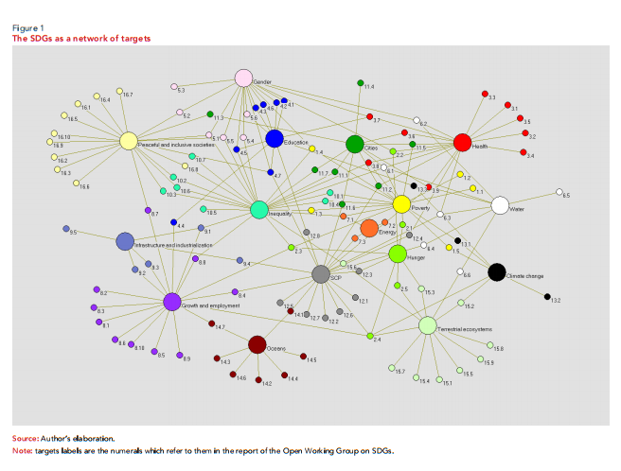
Source: Le Blanc, 2015

Slide 13
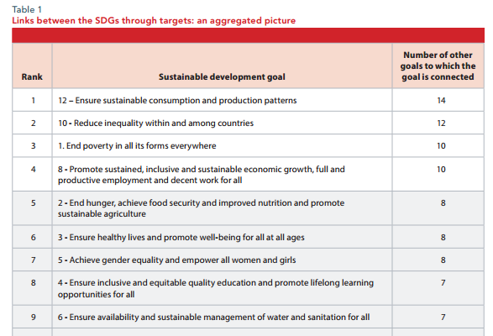

Slide 14
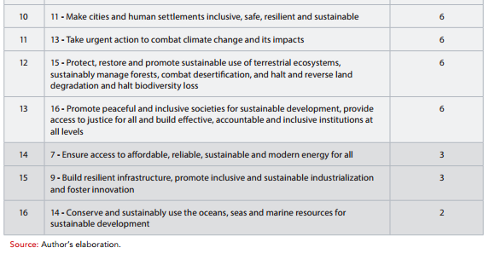
Source: Le Blanc, 2015

Slide 15
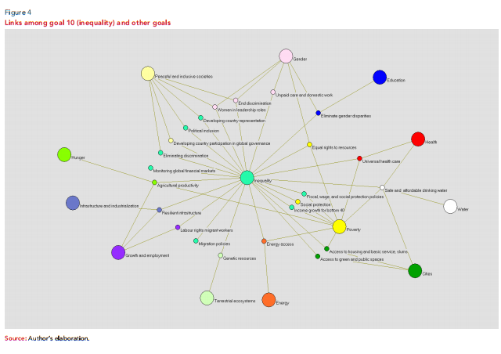
Source: Le Blanc, 2015

Slide 16
Goals and Targets:
As common benchmark of development performance
Have to take into account targets that refer to other goals
Look at multiple goals
Framework for policies
Basis for Comprehensive Policy Responses
Similar analysis at the National and Local Levels
Different emphasis for different countries

Slide 17
Example of Comprehensive Policy Responses (UNEP, 2015):
Economic:
Current pattern of resource use → need decoupling of economic development from environmental degradation ← replace inefficient processes
Role of market or policy induced increases in resource productivity
R&D investment to increase resource productivity

Slide 18
Social/human development:
Economic growth, urbanization and industrialization without proper environmental and natural resources concern → impact on health and livelihoods of people
Degradation of coastal resources
Poverty and its impact on human health and human development

Slide 19
5. Concluding Remarks
Each country specific framework and analysis
Build appropriate commitments supported by key policies and strategies involving all stakeholders
Utilizing global development cooperation opportunities on elements of SDGs (funding, capacity building, technology transfer, trade)
Utilization of Knowledge Sharing Platform
Various global development cooperation opportunities such as (Sachs, 2015):

Slide 20
    Global fund for education to ensure universal quality education
    Global fund for access in foreign countries
    Greater financing to avoid deforestation
    Restore productive lands
    Funding for global environment facility
    New funds for farmers

